Slide 1
Julie Mills, CEO & Group Principal
April 2019

Slide 2
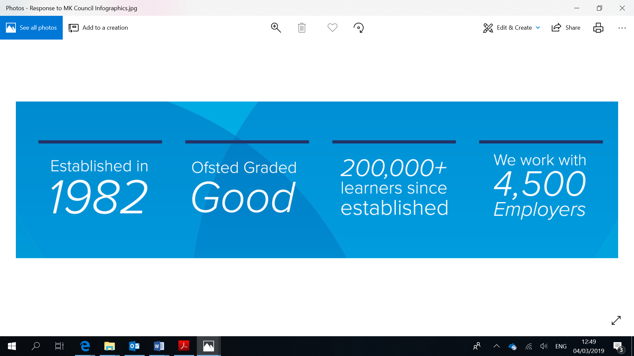
About MK College
Largest Further Education and training provider in MK
Qualifications: vocational courses, apprenticeships, higher education, professional certificates, employability skills and community training
National provider of education in prisons

Slide 3
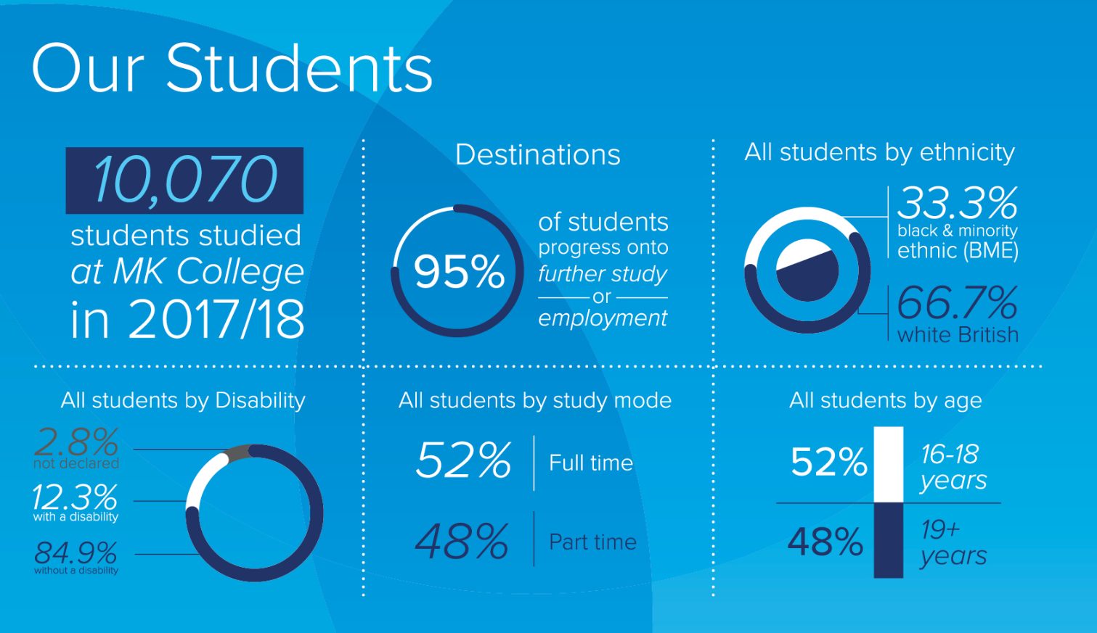

Slide 4
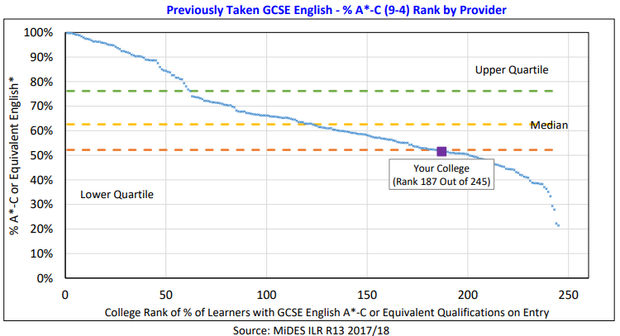
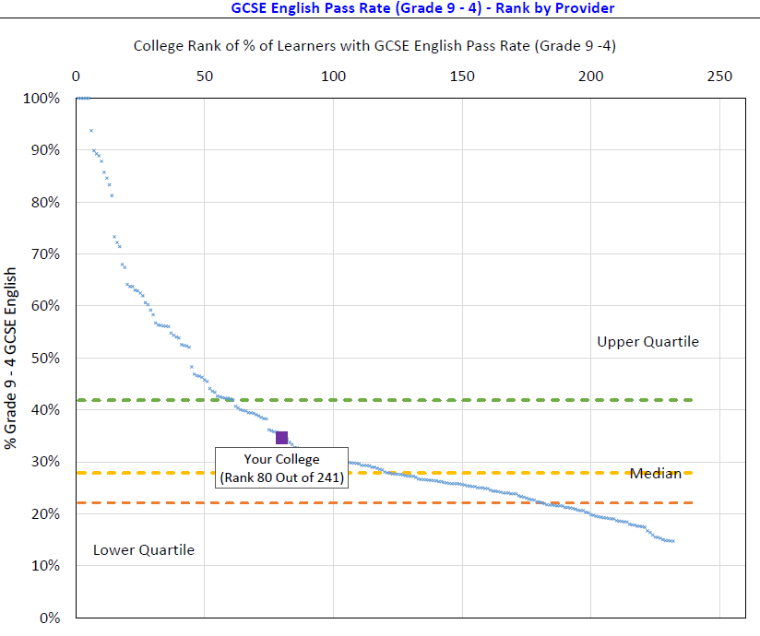
Student progression
English
Previously taken GCSE English - %A*-C (9-4) Rank by provider
GCSE English Pass rate (Grade 9-4) Rank by provider
Learning quarter in Milton Keynes
Ranking on arrival: 187 of 245
Ranking progression at MKC: 80 of 241

Slide 5
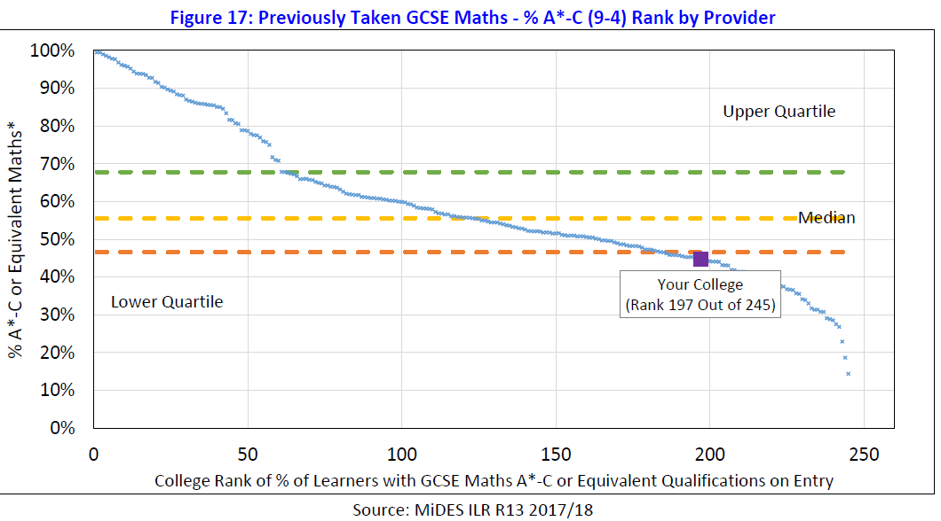
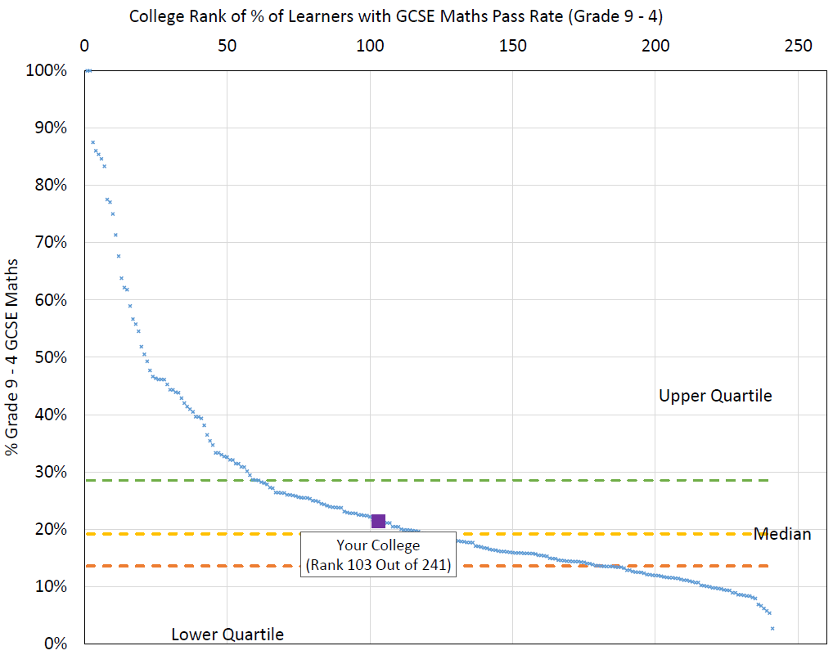
Student progression
Maths
Previously taken GCSE Maths - %A*-C (9-4) Rank by provider
GCSE Maths Pass rate (Grade 9-4) Rank by provider
Learning quarter in Milton Keynes
Ranking on arrival: 197 of 245
Ranking progression at MKC: 103 of 241

Slide 6
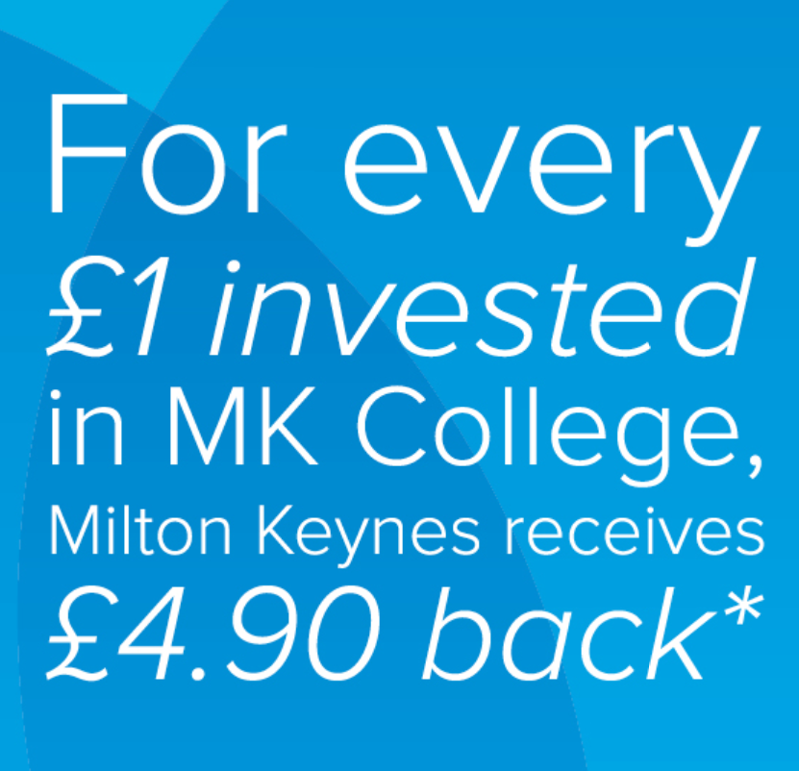
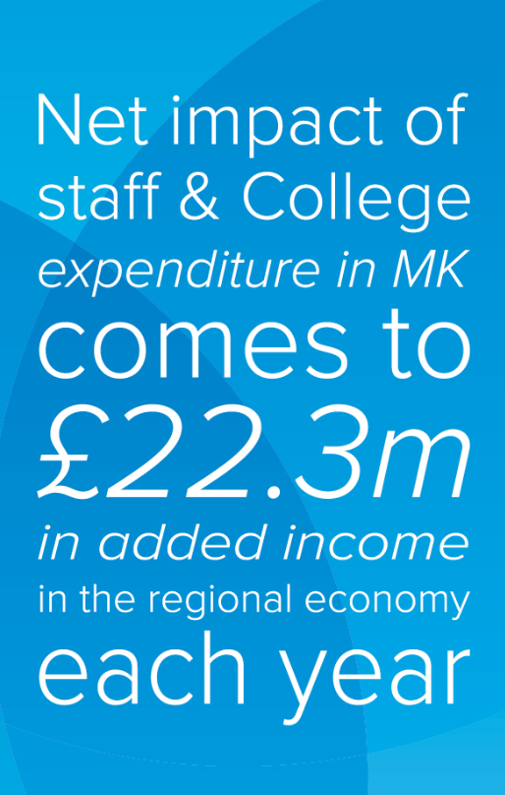
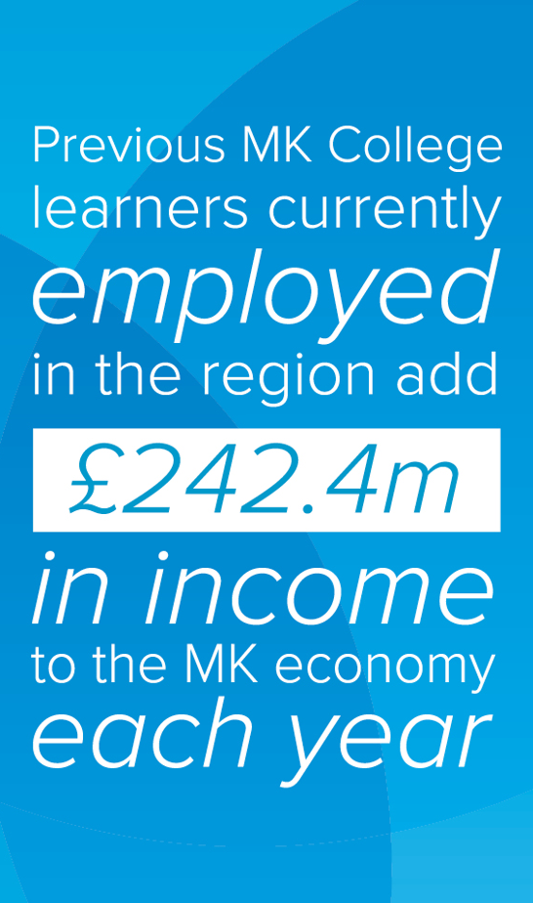
Value added

Slide 7
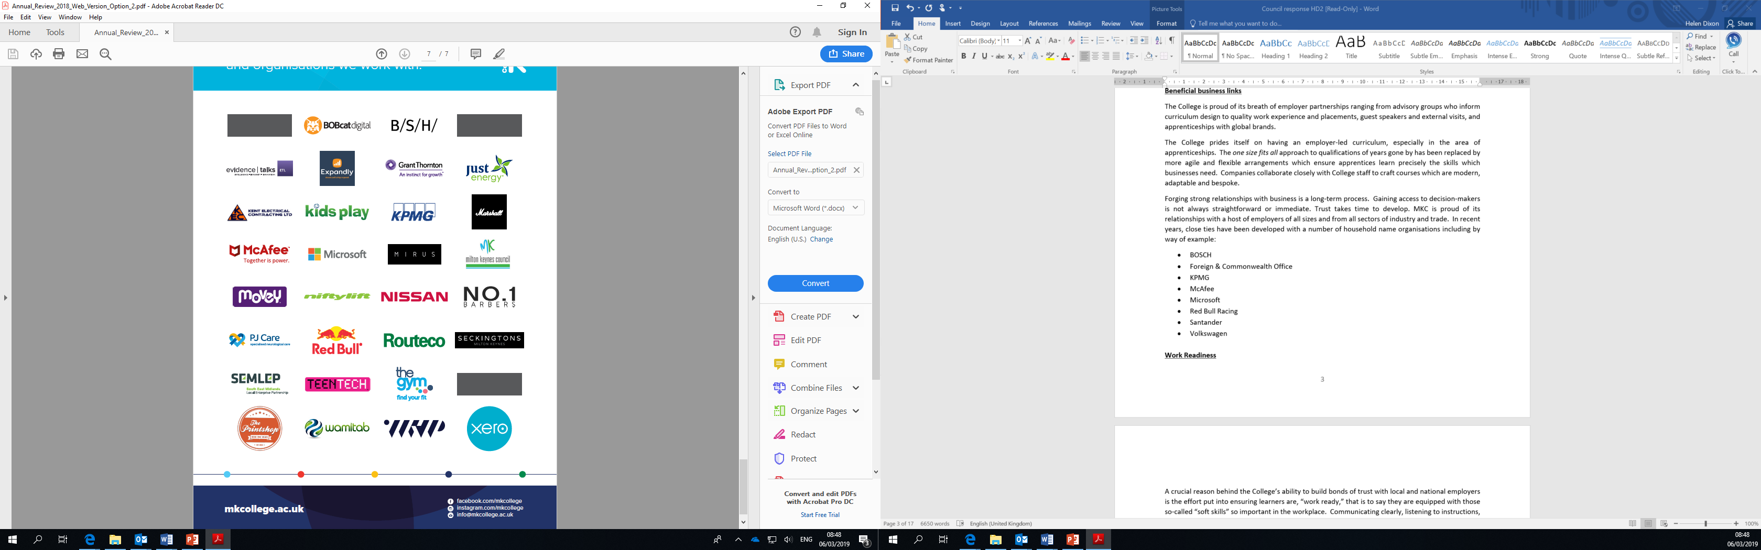

Strong partnerships

Slide 8
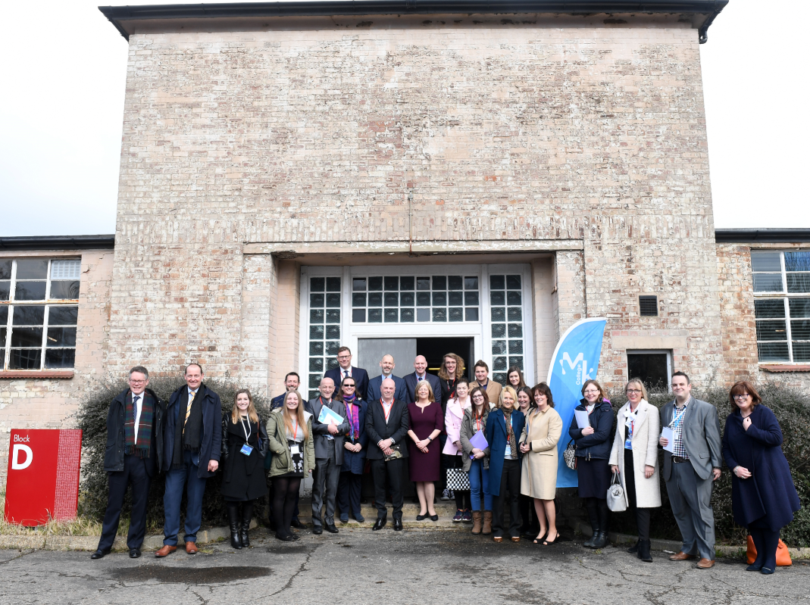
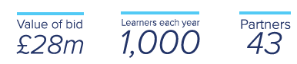
Institute of Digital Technology (IOT)
A Consortium led by MK College has won £28M from the Department for Education to launch an Institute of Digital Technology at Bletchley Park
Partners include Microsoft, KPMG, Cranfield University, MacAfee, supported by Bletchley Park Trust
1,000+ students will follow an employer-led curriculum designed to fill the digital skills shortage

Slide 9
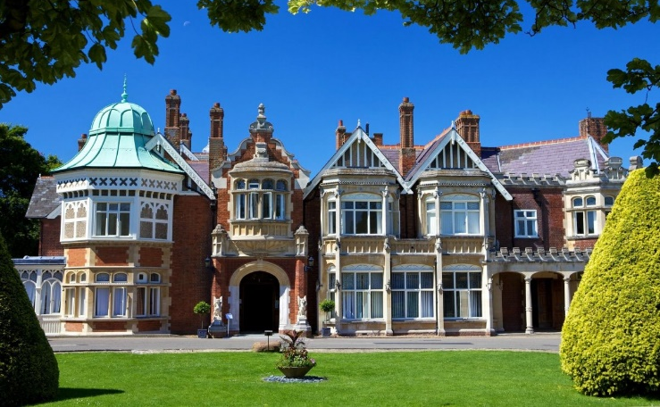
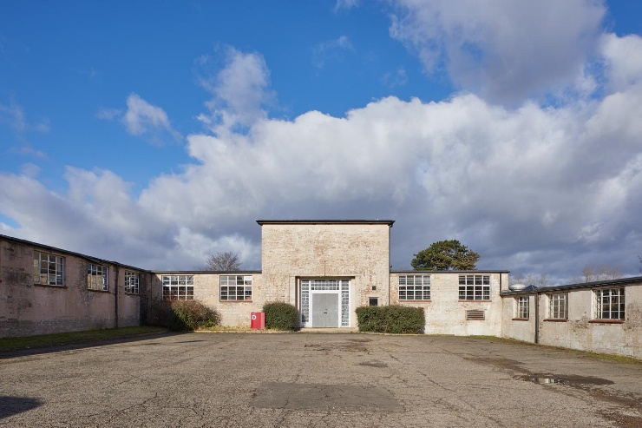

Institute of Digital Technology (IOT)
National recognition for partners
Restoration of
Block D
A legacy to inspire future generations

Slide 10
Institute of Digital Technology (IOT)
2nd stage bid successful
IOT Board formation
1st stage bid submitted
Restoration work begins
Block D at Bletchley Park Live
Grant confirmed
2nd stage bid submitted
2018
2019
2020
2021
Pre Award
Reading Live
Block V at Blackbird Leys Live
1st stage bid accepted
Interview
with DfE
1st Intake of IOT/MKC students
Lease acquisition

Slide 11



Institute of Digital Technology (IOT)
Focus: Working together to achieve the IOT

Slide 12
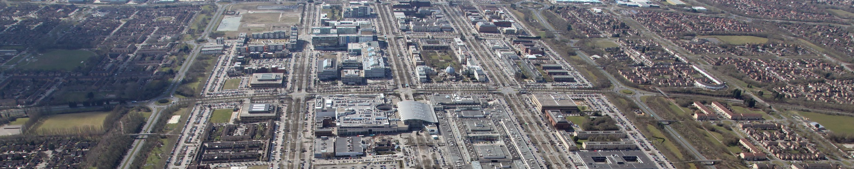
The vision of a single campus
Considerable benefits to be gained
Central location currently unavailable
Staying put for the foreseeable future
A single campus remains the ultimate vision.

Slide 13
Julie Mills, CEO & Group Principal
April 2019

