Slide 1
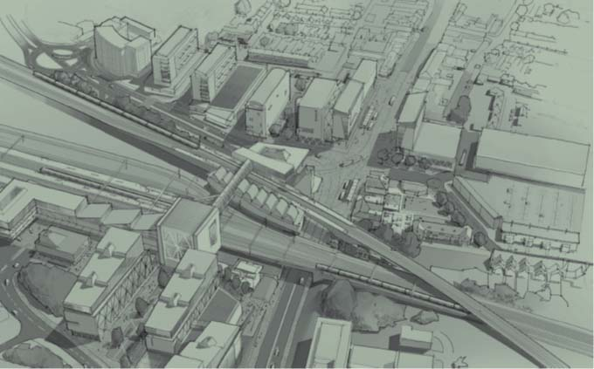

Central Bletchley UDF SPD
BPARA
17 May 2022
Paul Hammond - Area Manager - MK Land and Tariff
Matthew Clarke – Principal Urban Designer

Slide 2
Introduction to the SPD
Context :
SPD builds on the Central Bletchley Prospectus and provides design guidance to supplement Policy SD16 in Plan:MK
Helps to deliver the future vision for Central Bletchley (i.e. capitalising on the improved connectivity created by East West Rail)
A Transport and Parking Strategy forms part of the evidence base
SPD will provide design guidance for use by landowners and developers when preparing development proposals - creates more certainty.
It will be a material consideration when deciding planning applications in the area
Supports preparation of business cases for Town Deal projects
Can contribute to the content of the emerging Bletchley & Fenny Stratford Neighbourhood Plan, Dovetails with made ‘made’ West Bletchley Neighbourhood Plan
Notes:
Bletchley has been in the shadow of CMK there have been attempts to regenerate the town but other than the new leisure centre over a decade ago there has been little investment into Central Bletchley…….despite the 2004 SPG which outlined a huge range of opportunities and projects
EWR however now does provide a real stimulus for investment and renewal: as a major transport interchange Central Bletchley will benefit from unrivalled connectivity along the so called brain belt of Britain within the wider region and beyond.
The rail investment and connectivity will underpin growth and serve as a catalyst for transformational urban renewal and development creating a thriving and vibrant town centre within a city that is pedestrian scaled with genuine sustainable travel options and a strong link to its technology heritage

Slide 3
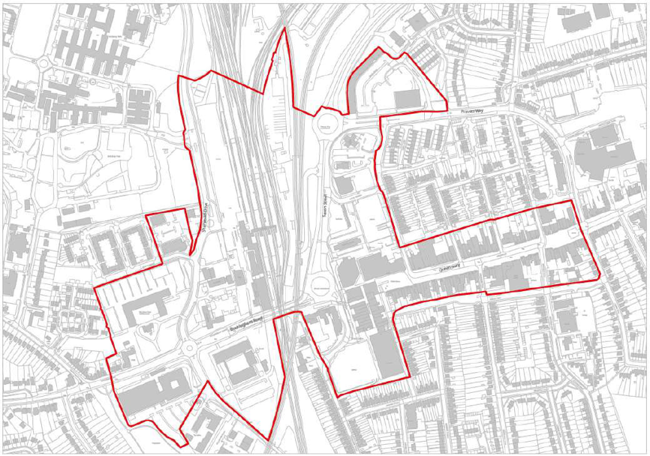
Context
Area covered by the Central Bletchley Prospectus and the new SPD

Slide 4
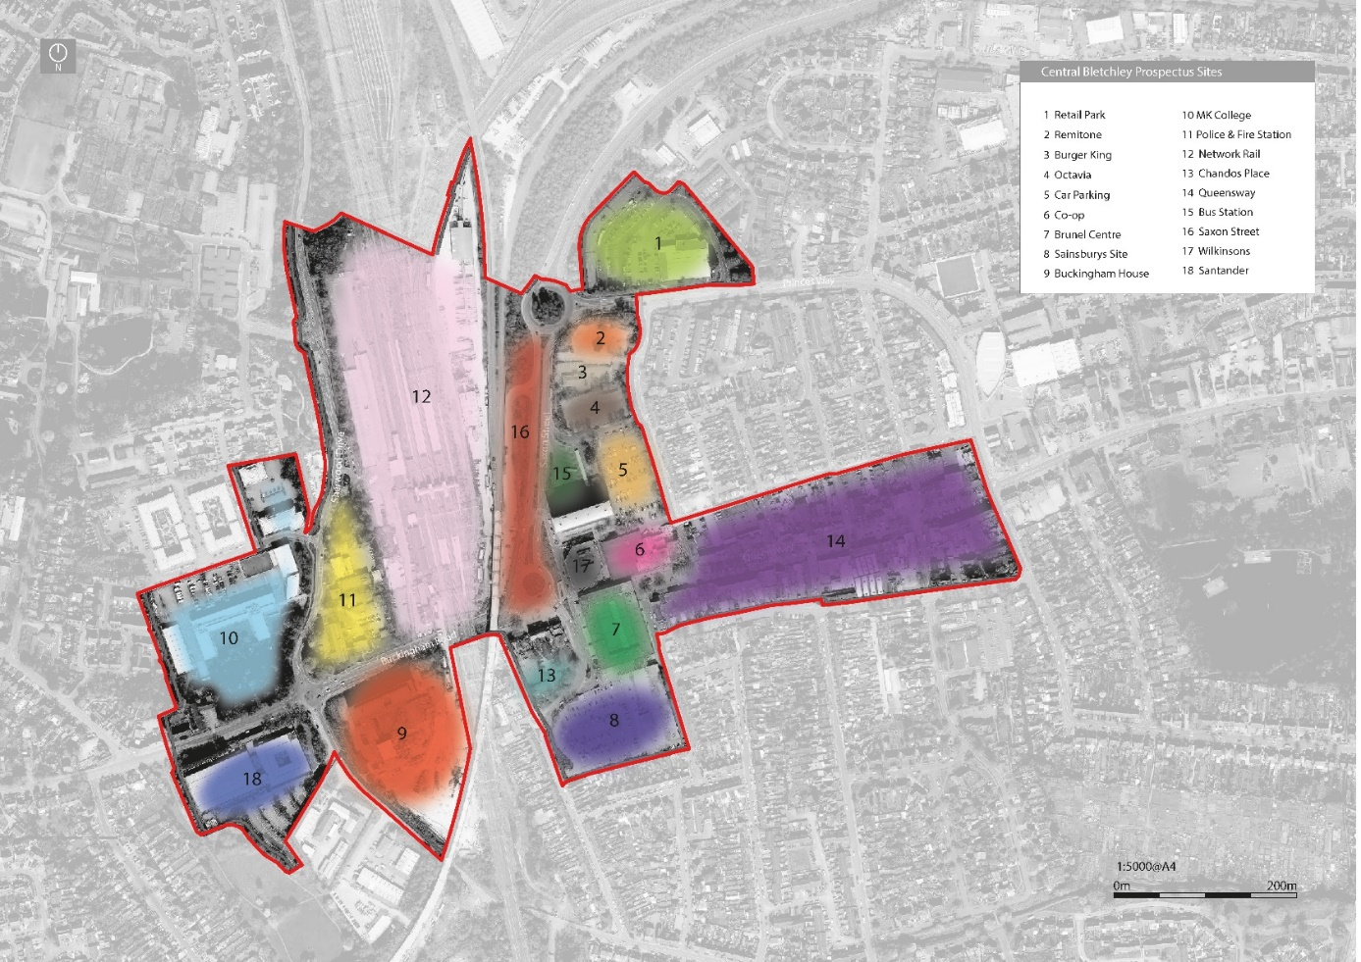
Opportunity Sites:

Slide 5
Relationship to Other Projects & Plans
Town Deal [TD]
  Additional design guidance to inform TD projects e.g. Public Realm Imps, Transport Hub & Innovation Hub projects
  Help support business cases
  Delivery
West Bletchley Council Neighbourhood Plan [‘made’ 2019]
Emerging Bletchley & Fenny Stratford Neighbourhood Plan
  SPD elements included in NP – greater planning ‘weight’
  Close liaison required
MK Council Plan
  Vision and Aims
  Council Plan Commitment 19
Notes:
Town Deal Business cases have to be submitted by March 2022 which ties in with completion of SPD
We are in discussion with BFSTC to discuss stakeholder engagement on the Neighbourhood Plan
We are hoping that the SPD will work alongside the BFSNP which is being prepared at the same time ensuring the documents work together.
Council Plan – SPD helps to deliver the 3 aims of ‘City of Opportunity’, ‘Affordable City’ and ‘Healthy City’
Creating walkable, sustainable, town centre locations should be considered key to the councils ambitious aim of being the ‘greenest city in the world’..

Slide 6
3, Placemaking Themes:
01- A Compact Central Bletchley
02 - Diversifying Uses and increasing housing choice
03 - An Improved Sense of Arrival
04 - Improving Routes and Spaces
05 - Breaking down the East-West ‘Divide’
06 - Creating a 'Place Identity' for Central Bletchley

Slide 7
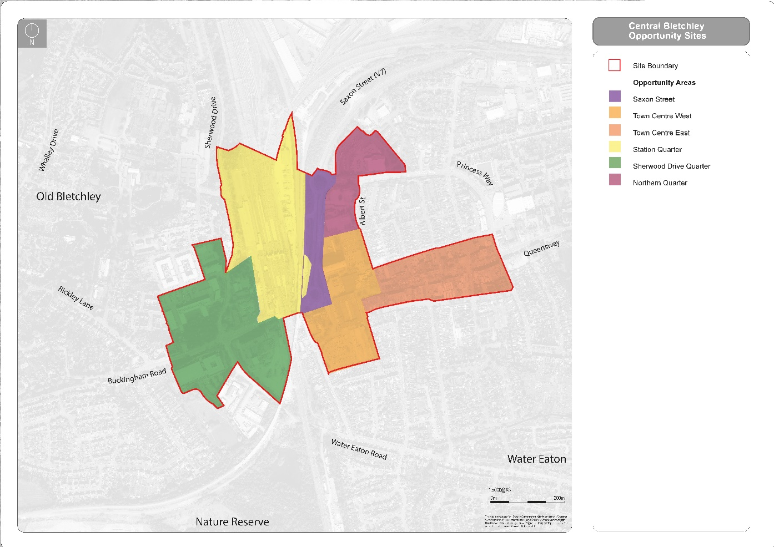
5, Opportunity Areas:

Slide 8
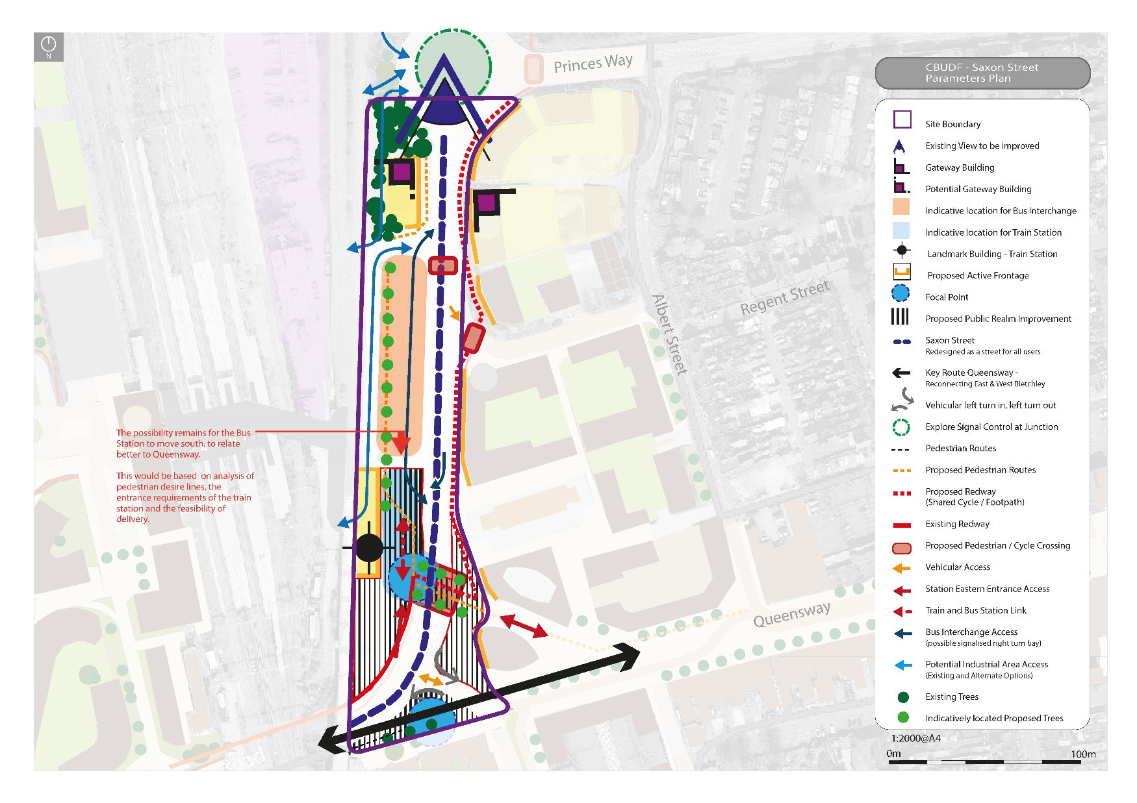
5, Saxon Street:
Notes:
The aim is to harness the potential of East-West Rail to create an eastern station entrance and associated transport interchange that faces the Town Centre. We will turn Saxon Street from a highway into a pedestrian scaled street, which will create a strong sense of arrival to Central Bletchley.
Improve the sense of arrival by reconfiguring Saxon Street between Princes Way and Brunel Roundabouts from a highway dominated hostile pedestrian environment into a pedestrian scaled and friendly street.
Includes a new modal transport interchange with an eastern train station entrance and new bus interchange.
Celebrate new eastern entrance with pedestrian plaza to the front.
New development directly abutting Saxon Street will contribute to the gateway by facing onto it. This will require the removal and building over of Locke Road.
Removal of Brunel Roundabout and inclusion of a shared surface type environment that allows pedestrians to easily and safely cross from the eastern entrance into the reconnected Queensway.

Slide 9
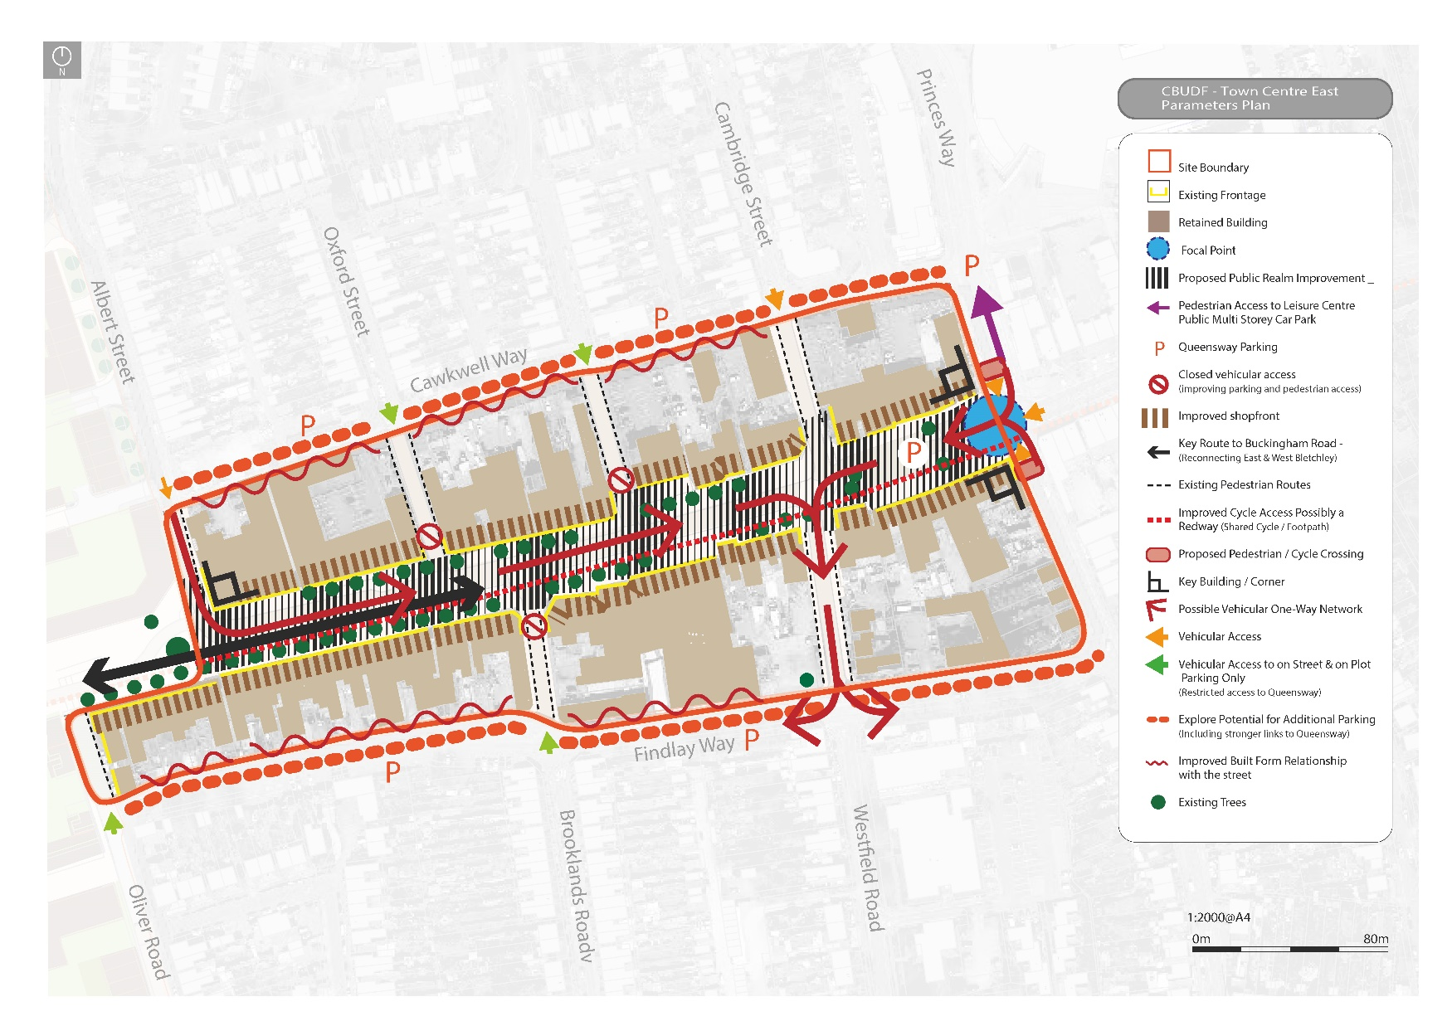
5, Town Centre East:
Notes:
Queensway will see public realm, wayfinding and parking / highway management improvements while a further diversification of typical high street uses will be sought as well as improved building stock.
Queensway should become a destination in its own right (versus a place people stop for 5 minutes, buy something and leave)
Diversification of shopping, leisure, and community offer in Queensway to increase pedestrian ‘dwell time’ and make it a busy, vibrant and sociable place.
Explore the potential relocation of Bletchley Library as part of a ‘ Health led Community Hub’ in/or as part of a redevelopment of the former Co-op building.
Open up Queensway to reconnect with Buckingham Road (dependent on Town Centre west opportunity area).
Improve the quality of the public realm in Queensway – making it more pedestrian friendly.
Improve the quality of pedestrian routes to Queensway, particularly from the north and south.
Improve the quality of the environment and range of activities and events within Stanier Square.

Slide 10
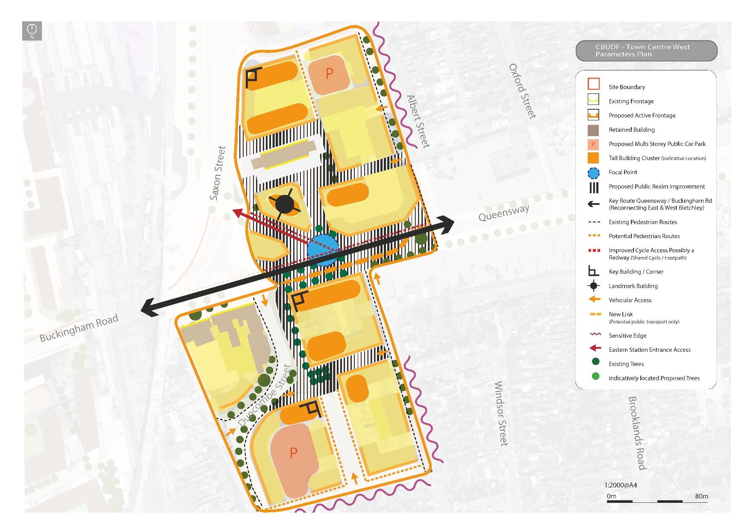
5, Town Centre West:
Notes:
We will work with landowners to enable the development of underutilised buildings and sites with higher density residential led mixed-use development that revitalises the Town Centre.
Redevelopment of the closed Sainsbury’s store at the southern end of this opportunity area together with more efficient use of the existing surface level car park.
Redevelopment of the Brunel Centre and Wilko which will enable the reconnection of Queensway to Buckingham Road, creating a pedestrian scaled and friendly public realm.
Explore the potential relocation of Bletchley Library as part of a ‘ Health led Community Hub’ in/or as part of a redevelopment of the former Co-op building.
Redevelopment of the council owned surface level car park adjacent to Albert Street.
The relocation of the existing bus station and subsequent redevelopment of the site.
Improved quality public realm around Stephenson House.

Slide 11
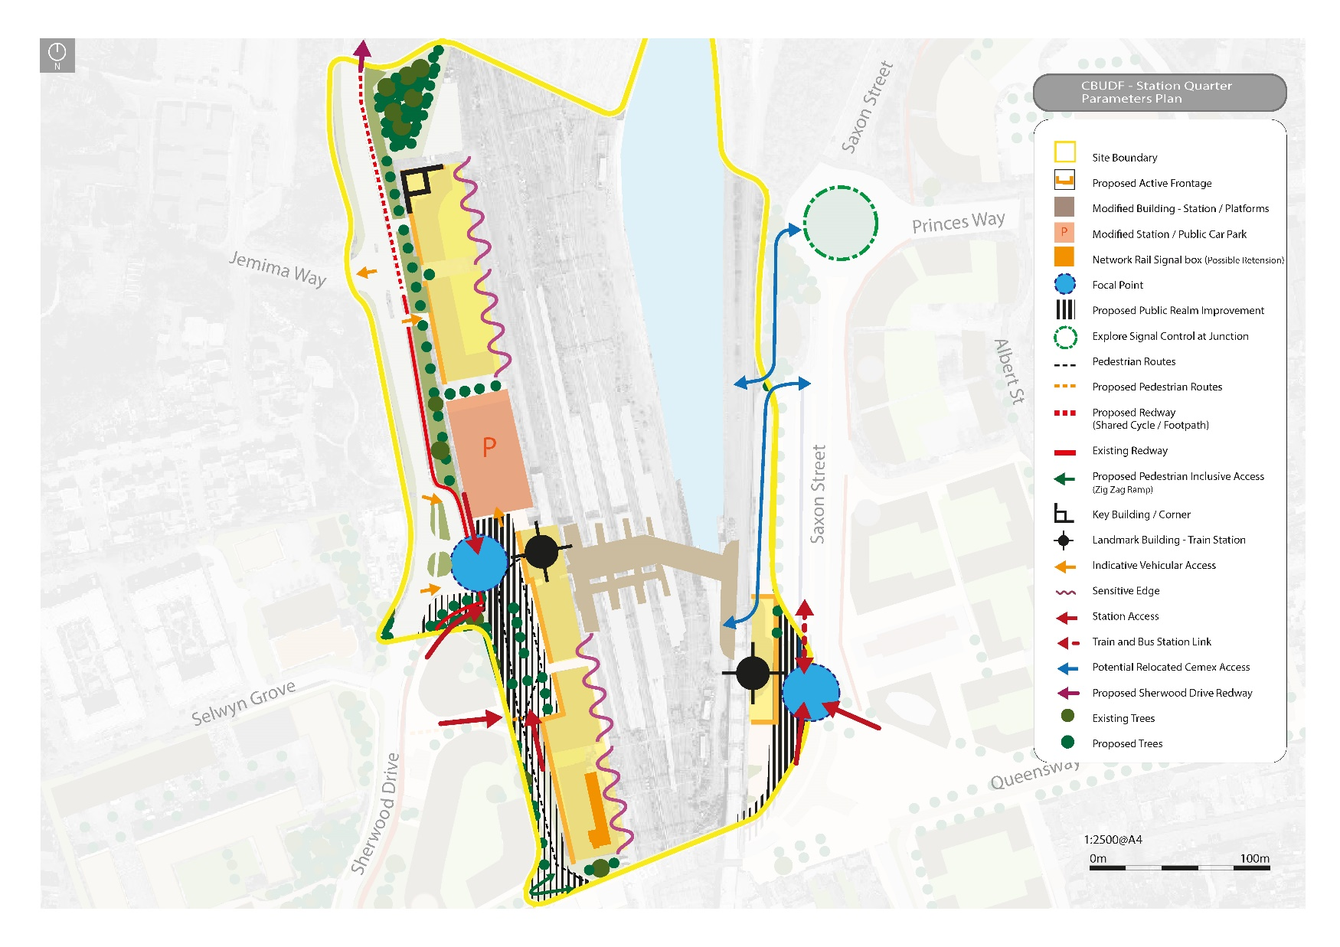
5, Station Quarter:
Notes:
Improved connectivity will enable this area to become a thriving mixed-use quarter, comprising uses compatible with proximity to a train station and the tourist attraction, Bletchley Park.
New station buildings associated with existing western and new eastern entrance.
Improved public realm around existing western station entrance.
New eastern entrance and associated modal interchange associated with relocated bus station.
Promote redevelopment of certain Network Rail assets including the existing Signal Box, staff accommodation and station entrance building as well as consolidating the existing decked car park into a smaller footprint that frees up land to the north for new development.
Improved the quality of existing pedestrian route that passes behind the police and former fire station sites.

Slide 12
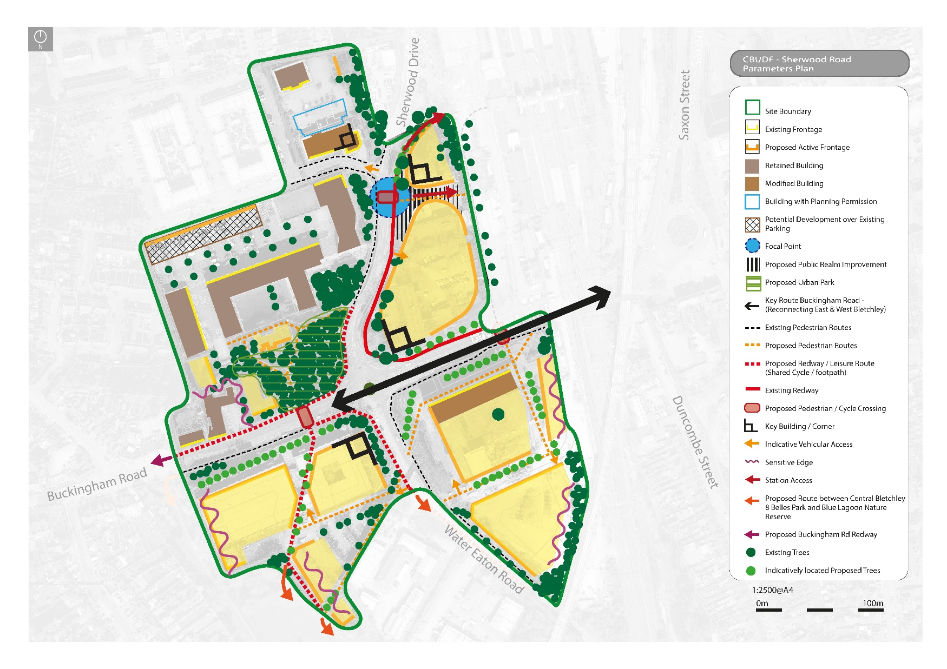
5, Sherwood Drive:
Notes:
We will work with landowners to enable the reuse and / or redevelopment of existing buildings and associated land to create high quality new residential led mixed use development.
Redevelopment of Police and Fire Station Site for mixed use development including an Innovation Hub.
Development of Institute of Technology at Milton Keynes College in conjunction with a Tech Park.
Creation of an Urban Park and potential supporting development at the former Cricket Pavilion Site.
Conversion of Mercury House and new development to the rear of it.
Redevelopment of Buckingham House and incorporation of key pedestrian route linking to wider green spaces

Slide 13
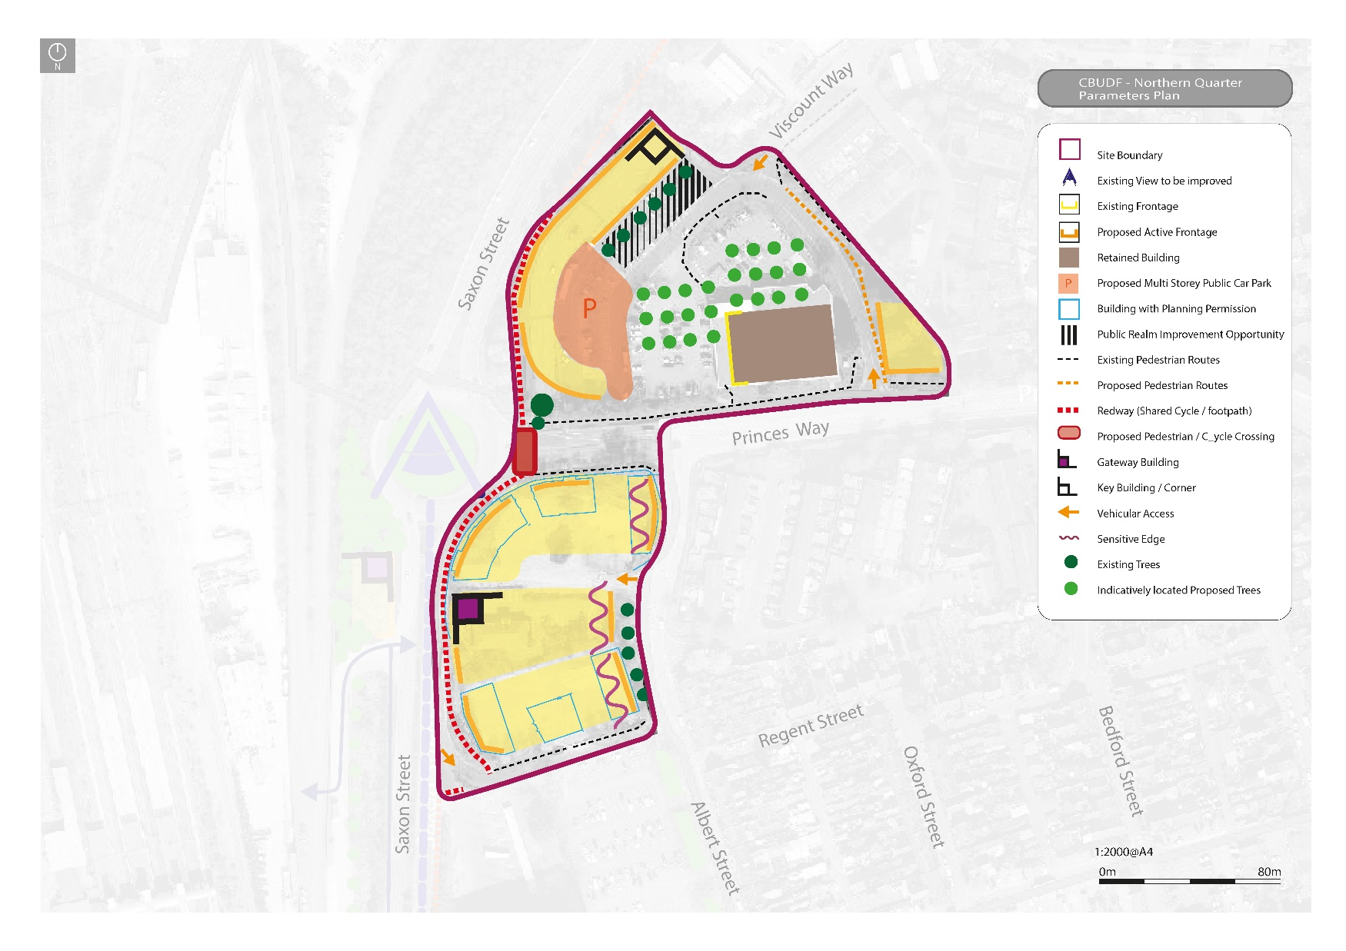
5, Northern Quarter:
Notes:
This area is currently occupied by a retail park, but as land becomes more valuable, given the locational benefits East-West Rail brings, it could be redeveloped for higher density housing with mixed use ground floors. This will provide a positive interface with Saxon Street, as well as potentially a new multi-storey car park serving the Town Centre.
New development helps transform Saxon Street to provide a high quality sense of arrival from the north.
Residential uses on the southern portion of this area have planning permission and will provide a critical mass of residents to support the vitality of the town centre.
The northern portion of this area represents a potential longer term opportunity for intensification of development.

Slide 14
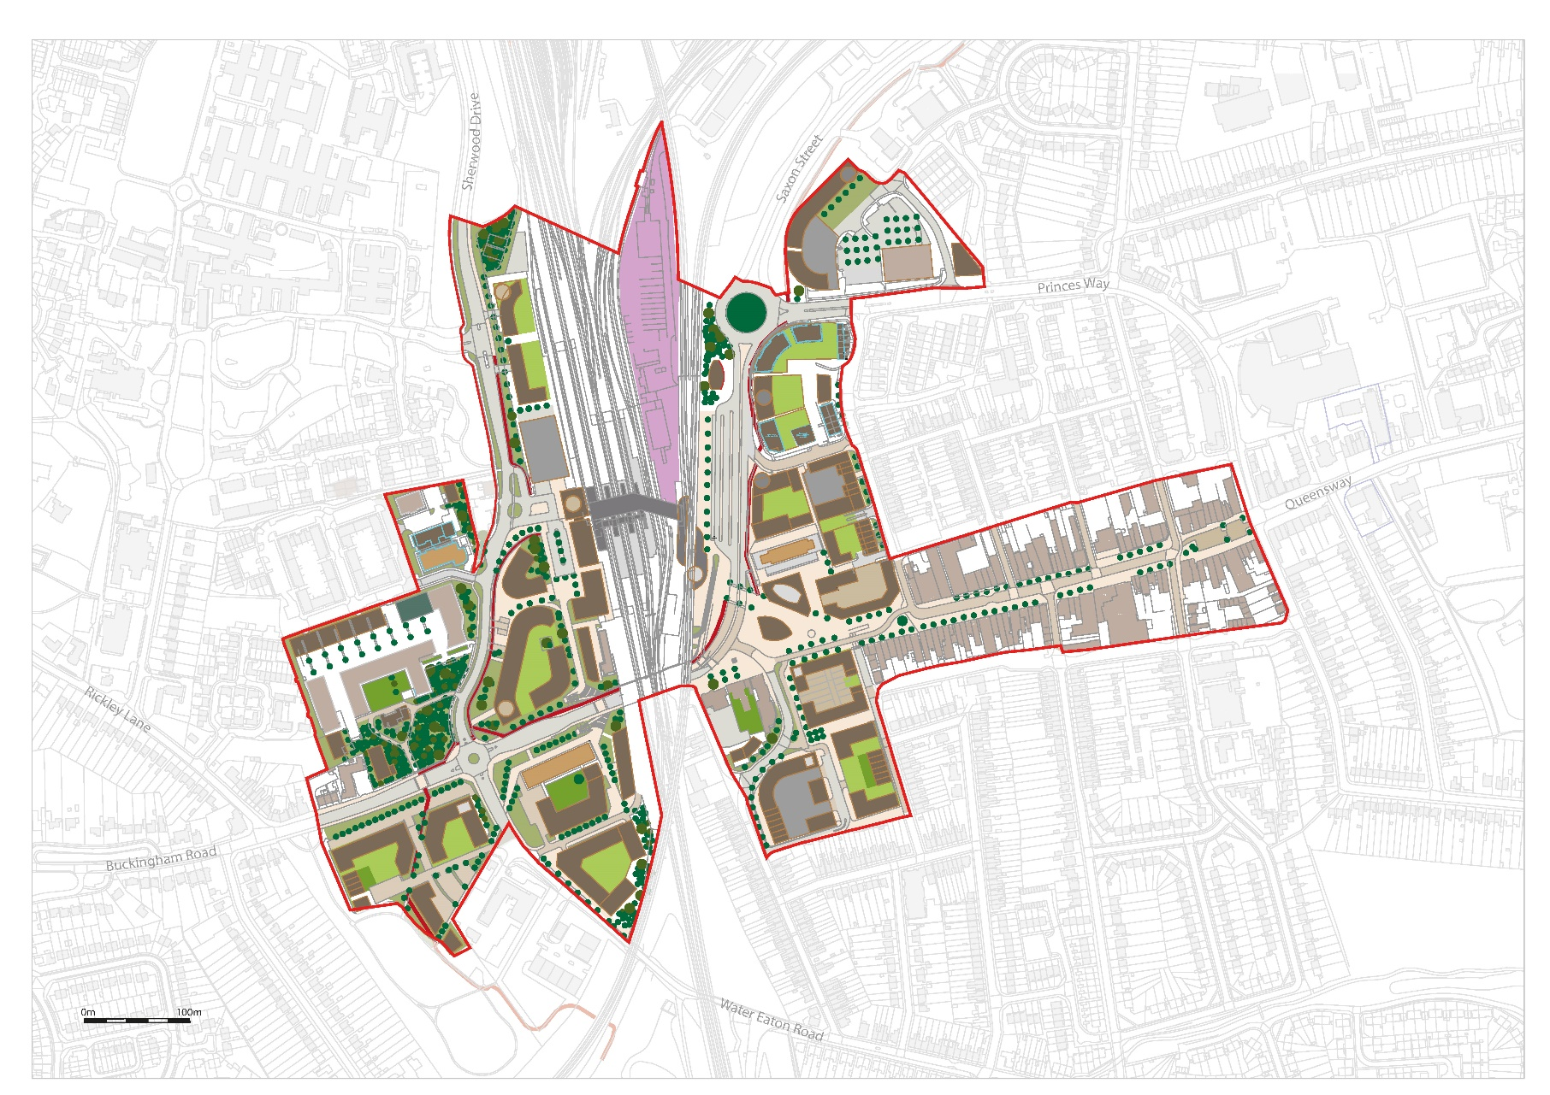
5, Illustrative Masterplan:

Slide 15
Document Approved 22 March 2022
Documents are available on the Council’s website
Printed copies deposited at the Central Library in CMK as well as Bletchley Library.

