Slide 1

MK: Bletchley & Fenny Stratford
Town Deal
John Cove
Chair, B&FS Town Deal Board
BPARA Briefing
May 2022

Slide 2
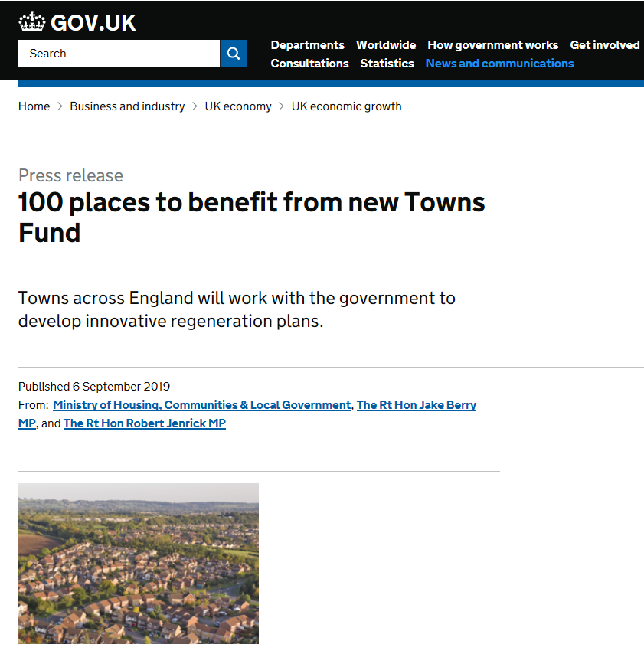
Towns Fund – background to the bid
£3.6bn fund to support towns to build prosperous futures - up to £25m per town
101 places identified, including MK, to work with government to develop “innovative regeneration plans”
Town Deals are part of the commitment to “levelling up” regions
Bletchley & Fenny Stratford Town Deal - building on renewal opportunities flowing from East-West Rail

Slide 3
Town Deal ‘Intervention Area’

Slide 4
MK: B&FS Town Deal Board
Formed July, 2020 with private sector 'chair'.
Milton Keynes Council is the 'Accountable Body'
Set out the Town Deal Vision
Stakeholder Engagement Lead
Developed the Town Investment Plan [TIP]
Submitted the B&FS Town Deal funding bid & secured investment [£22.7 million]
Developing 9# Business Cases
Monitoring & Evaluation
Board Review & Skills Audit

Slide 5
Town Deal Board - Current Members
• John Cove, Chair of the Board and Chairman of Milton Keynes Dons FC Sport & Education Trust
• Councillor Pete Marland, Leader of Milton Keynes Council
• Delia Shephard, Bletchley & Fenny Stratford Town Council
• Helen Hupton, West Bletchley Council
• Angie Ravn-Aagaard, Treasurer of the Consortium of Bletchley Residents Associations [COBRA]
• Ian Revell, CEO of MK Community Foundation
• Dr Julie Mills OBE, CEO and Group Principal of MK College
• Oliver Mytton, Deputy Director of Public Health at Milton Keynes Council
• Matthew Green, Property Development Director, Milton Keynes Development Partnership
• Hilary Chipping, CEO at the South East Midlands Local Enterprise Partnership [SEMLEP]
• Peter Hume, Senior Programme Manager at Network Rail/EWR
• Iain Stewart MP, Member of Parliament for Milton Keynes South
• Dr Vann Canthaboo, GP at Westfield Road Surgery

Slide 6
MK: Bletchley & Fenny Stratford
Town Deal - Vision
  Bletchley and Fenny Stratford: connecting people, business and places today and tomorrow
“Bletchley and Fenny Stratford will be a thriving, healthy, affordable and attractive place, where its diverse communities are celebrated and connected to opportunities to live, work and play. It will be a centre for innovation, benefitting from its excellent strategic rail connections to London, Oxford and Cambridge and taking forward the pioneering and enduring legacy of Bletchley Park to provide a bright future for all”

Slide 7
Stakeholder Engagement approach
Stakeholder engagement is a key requirement of the Town Deal bid
Stakeholder Engagement Plan prepared and submitted alongside the TIP in October 2020
3 stages, building on previous engagement and consultation:
Stage 1: awareness raising, identifying challenges & opportunities
Stage 2: vision & objectives plus project prioritisation - feedback and information
Stage 3: Post bid submission - information and engagement on project development & implementation

Slide 8
Town Investment Plan [TIP] – submitted October 2020
Themes:
  Urban regeneration, planning & land use, including culture & heritage
  Connectivity: local transport & digital
  Skills & enterprise infrastructure
Evidence of Need [i.e. deprivation]
Vision & Objectives
Theory of Change & Project Prioritisation:
  Market failure
  Outputs
  Outcomes
  Intended impacts

Slide 9
MK: Bletchley & Fenny Stratford Town Deal -
Our Journey to Bid Submission
6 October: Check and Challenge
31 July '20
Deadline for TIP Project ideas
17 July '20
Deadline for Accelerated Project ideas
TIP submitted 30 October ’20
3 July '20
Town Deal Board Meeting #1
2 October '20
Final fund objectives agreed
TIP projects short-listed
27 October '20
Delegated Decision on TIP
August '20
Sub Group Meetings
30 July '20
TD Board #2
Appointment of Hatch and HYAS
17 Sept '20
TD Board #3
Agreed Vision and Objectives
22 October '20
TD Board #4
Agree Draft TIP
August – October: Questionnaire Survey

Slide 10
Town Investment Plan Bid – The Projects [October 2021]

Slide 11
Funding announcement …….
Successful funding announcement, 3 March 2021
£22.7 million Town Deal offered - all projects supported, some with conditions attached:
“The delivery of this deal should integrate with wider considerations including the government’s significant investment in East West Rail to use this opportunity for regeneration and development in and around Bletchley station catalysed by the new connectivity opportunities ….
…. This is an exciting opportunity to come together to drive long-term economic and productivity growth in Milton Keynes, particularly as we meet the challenges presented by Covid-19.”
MHCLG grant funding letter received 15 July 2021 following the submission of 9# project confirmation tables & financial profile.

Slide 12
Town Deal Governance
Town Deal Board
Sets the TD Vision
Develops the TIP
Co-ordinates resources
Influences Stakeholders
Monitors Project Progress
Leads Engagement
Town Deal Implementation Group
Coordination, management & delivery of actions
Implementation of the TIP
Provides Board Secretariat
Oversees consultation & engagement
Town Deal Board
Milton Keynes Council
MK Approach PM methodology
Corp Portfolio Board
Council/Cabinet Approval
Town Deal Implementation Group
Milton Keynes Development Partnership
MKC
Accountable body
Supports Board with governance, assurance & decision making functions:
  Cabinet
  S.151 Officer
  Corporate Portfolio Board
  SEMLEP
Milton Keynes Development Partnership
Provide ‘expert’ advice on development strategy
Manages the Revolving Development Fund [RDF]
Delivers the Innovation Hub project.

Slide 13
Business Cases
A detailed and proportionate business case must be developed for each project to draw down government funding
Consultants were procured to help write the business cases
Business cases subject to internal assurance process and signed off by the Town Deal Board
Summary business cases for all projects need to be submitted to government
7# Summary business cases submitted to date
2# Summary business cases to be submitted by summer 2022, notably:
  Innovation Hub
  Transport Hub

Slide 14
Next steps …….
Business case approval: Transport & Innovation Hubs
Monitoring & Evaluation
Review of Town Deal Board role & skills to enable project delivery
Accelerated Projects
Oct ’20 +:
Former fire station
Redway links

Slide 15
Thank you for listening …….
……. any questions?

