Slide 1


Brunel Centre Development Brief
David Blandamer - Senior Urban Designer (MKCC)
Adam Sciberras - Special Projects Director (MKDP)
West Bletchley Town Council 23 October 2023

Slide 2
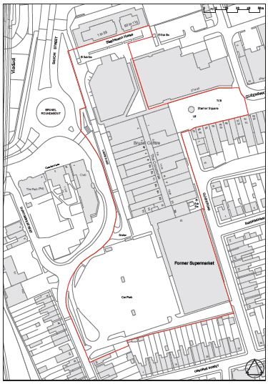
Brief Area
The brief covers the Brunel Centre, the former Sainsbury’s and Wilko stores and Stanier Square
The site is in the ownership of MKDP and MKCC

Slide 3
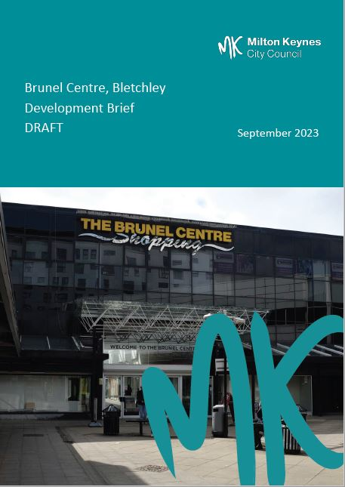
Purpose and Status of Brief
Provides planning guidance and design principles for development of the site.
Not a planning document.
A material consideration in determining applications albeit with limited planning weight.
Assist with marketing of the site by MKDP.

Slide 4
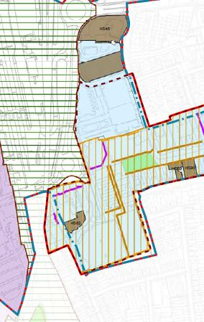
Policy Context: Plan:MK
Policy SD16 provides strategic policy for the wider Central Bletchley area
Policy ER9 designates Bletchley as a town centre in the retail hierarchy
Policy ER18 – the interior of the Brunel Centre and the front of the former Sainsbury’s are primary frontages

Slide 5
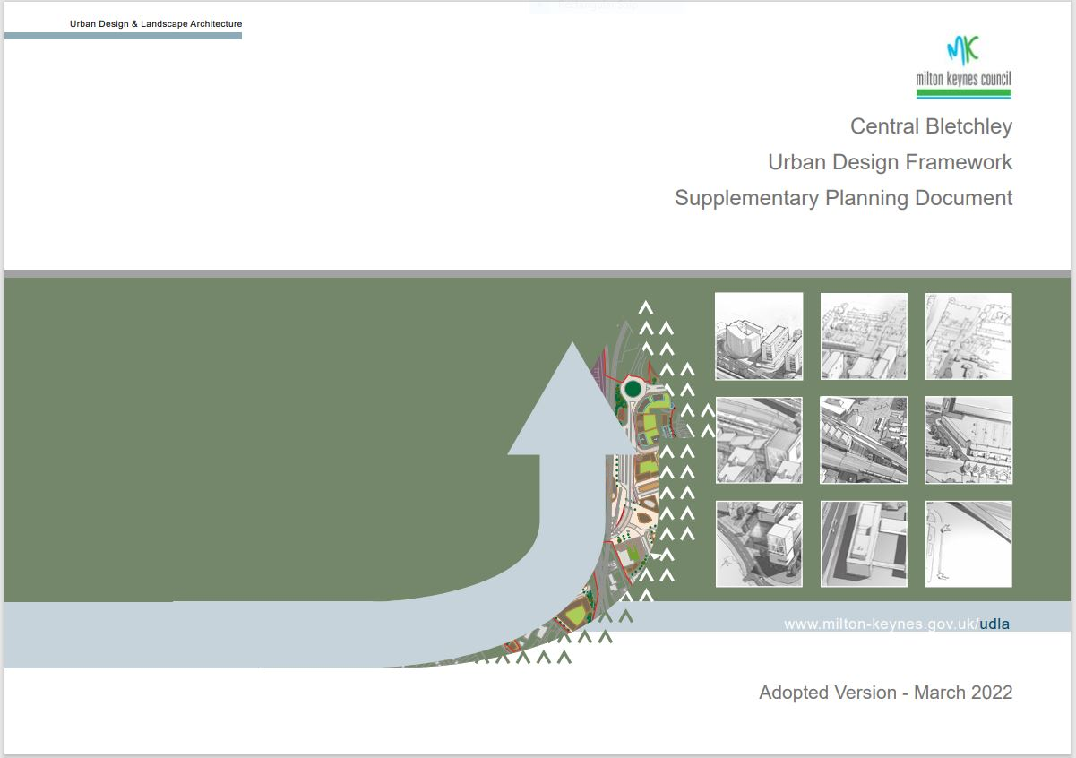
Policy Context: Central Bletchley Urban Design Framework SPD
Adopted March 2022
Material consideration in planning decisions
Brunel Centre site lies within Town Centre West Opportunity Area
Development should take account of proposals for the adjoining opportunity areas

Slide 6
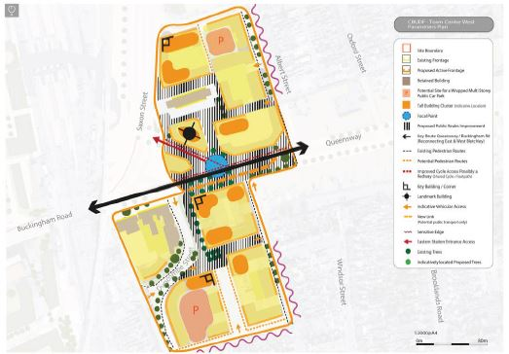
Policy Context: Central Bletchley Urban Design Framework SPD
Establishes key development principles
Redevelopment of the site
Reconnection of Queensway to Buckingham Road

Slide 7
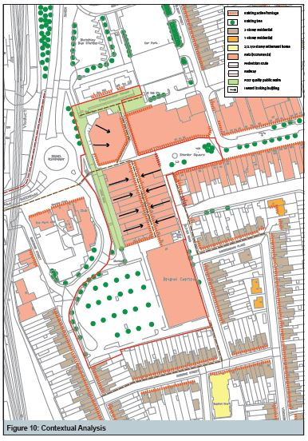
Contextual Analysis
Current uses on the site
Surrounding uses and built form
Access and transport

Slide 8
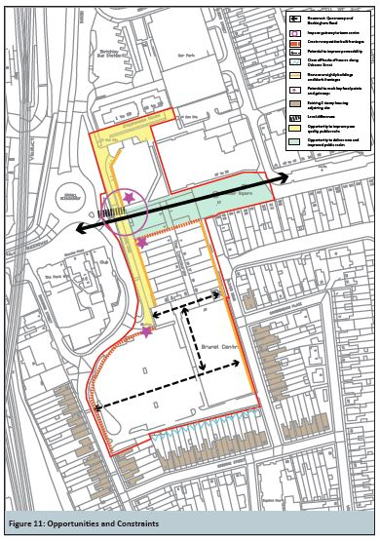
Opportunities and Constraints
Opportunity to reconnect Queensway and Buckingham Road
Mark key focal points and gateway to town centre
Create positive frontages to public realm
Improve pedestrian permeability
Existing 2 storey housing
Level differences
Accommodating servicing

Slide 9
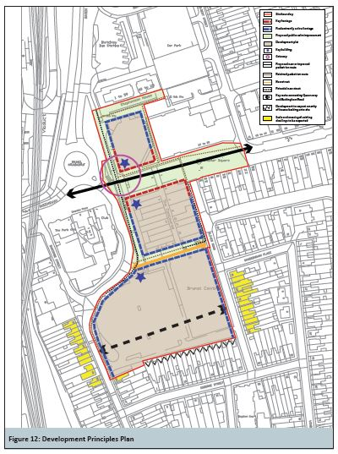
Development Principles
Mixed use development including housing
Ground floor active retail frontages
Complementary town centre uses
Outward facing development

Slide 10
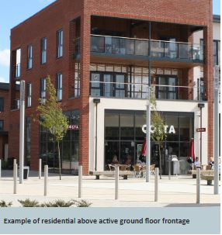
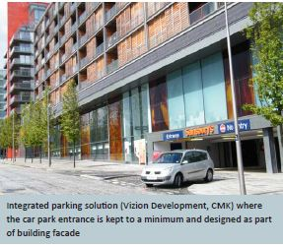
Development Principles
Reconnect Queensway and Buckingham Road
Active frontages to Duncombe Street and Oliver Road
Taller buildings capitalising on Central Bletchley’s sustainable location
Scale and massing to respect adjoining housing

Slide 11
Next Steps
Consultation runs until Thursday 23 November
Comments by email to urban.design@milton-Keynes.gov.uk or in writing to Urban Design Team, Civic, 1 Saxon Gate East, Milton Keynes MK9 3EJ
Approval of final Brief by MKCC in the New Year

Slide 12
Any Questions?

