Slide 1




Bletchley and Fenny Stratford BPARA Annual Meeting
Town Deal Update
Darrel Canvin, Town Deal Programme Manager
May 2024

Slide 2
What is the Towns Fund
In recent years, our towns and high streets have faced several significant challenges to growth.
The Town Deals programme aims to help regenerate towns and deliver long-term economic and productivity growth.
In 2020, Milton Keynes City Council were awarded £22.7 million of Town Deal Funding to deliver several projects in Bletchley and Fenny Stratford.
These projects are designed to capitalise on the emerging opportunities presented by the development of the Oxford to Cambridge East-West rail link.

Slide 3
Town Deal Vision
Bletchley & Fenny Stratford will be a thriving, healthy, affordable and attractive place, where its diverse communities are celebrated and connected to opportunities to live, work and play. It will be a centre for innovation, benefitting from its excellent strategic rail connections to London, Oxford and Cambridge and taking forward the pioneering and enduring legacy of Bletchley Park to provide a bright future for all
Skills & Enterprise Infrastructure
Physical & Social Connectivity
Regeneration & Land use

Slide 4
Project Updates
Revolving Development Fund
Redevelopment brief has now been approved which sets out the parameters for development on this site.
Saxon Street / Transport Hub
Technical survey work underway which will help inform scheme designs
Queensway & Aylesbury Street
Technical survey work underway which will help inform scheme designs
Looking to seek a development partner later this year with the potential redevelopment happening in 2026
Former Sainsburys to be demolished this summer
Plan is to improve connectivity and provide enhanced pedestrianisation between Queensway and the Train station
Plan is to make both streets more pedestrian friendly and create a more useable space which includes new pathing, street furniture, planters, rationalised parking and space for shops to extend onto the street

Slide 5
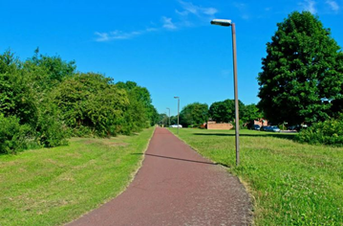
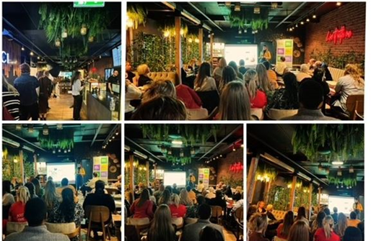
Ongoing projects
The Council are nearing completion (minor landscaping works ongoing) on the Redways project, which has provided enhanced connectivity from the Lakes Estate, Newton Leys and Blue Lagoon Nature Reserve to Bletchley Town centre | The AMoVS project aims to market Bletchley as a great place to invest and do business, by engaging with businesses across the area. Throughout the year we held four business networking events and engaged with over 100 businesses.

Slide 6
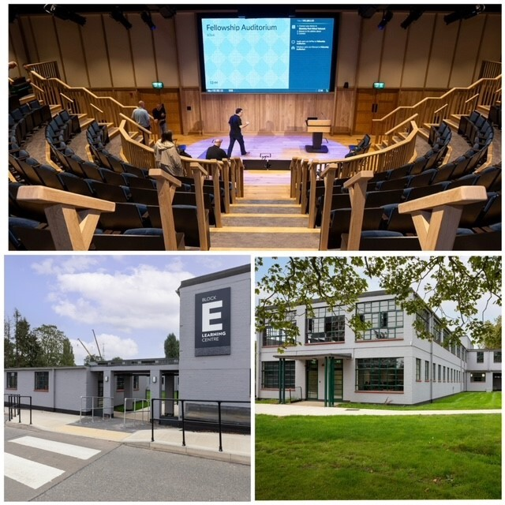
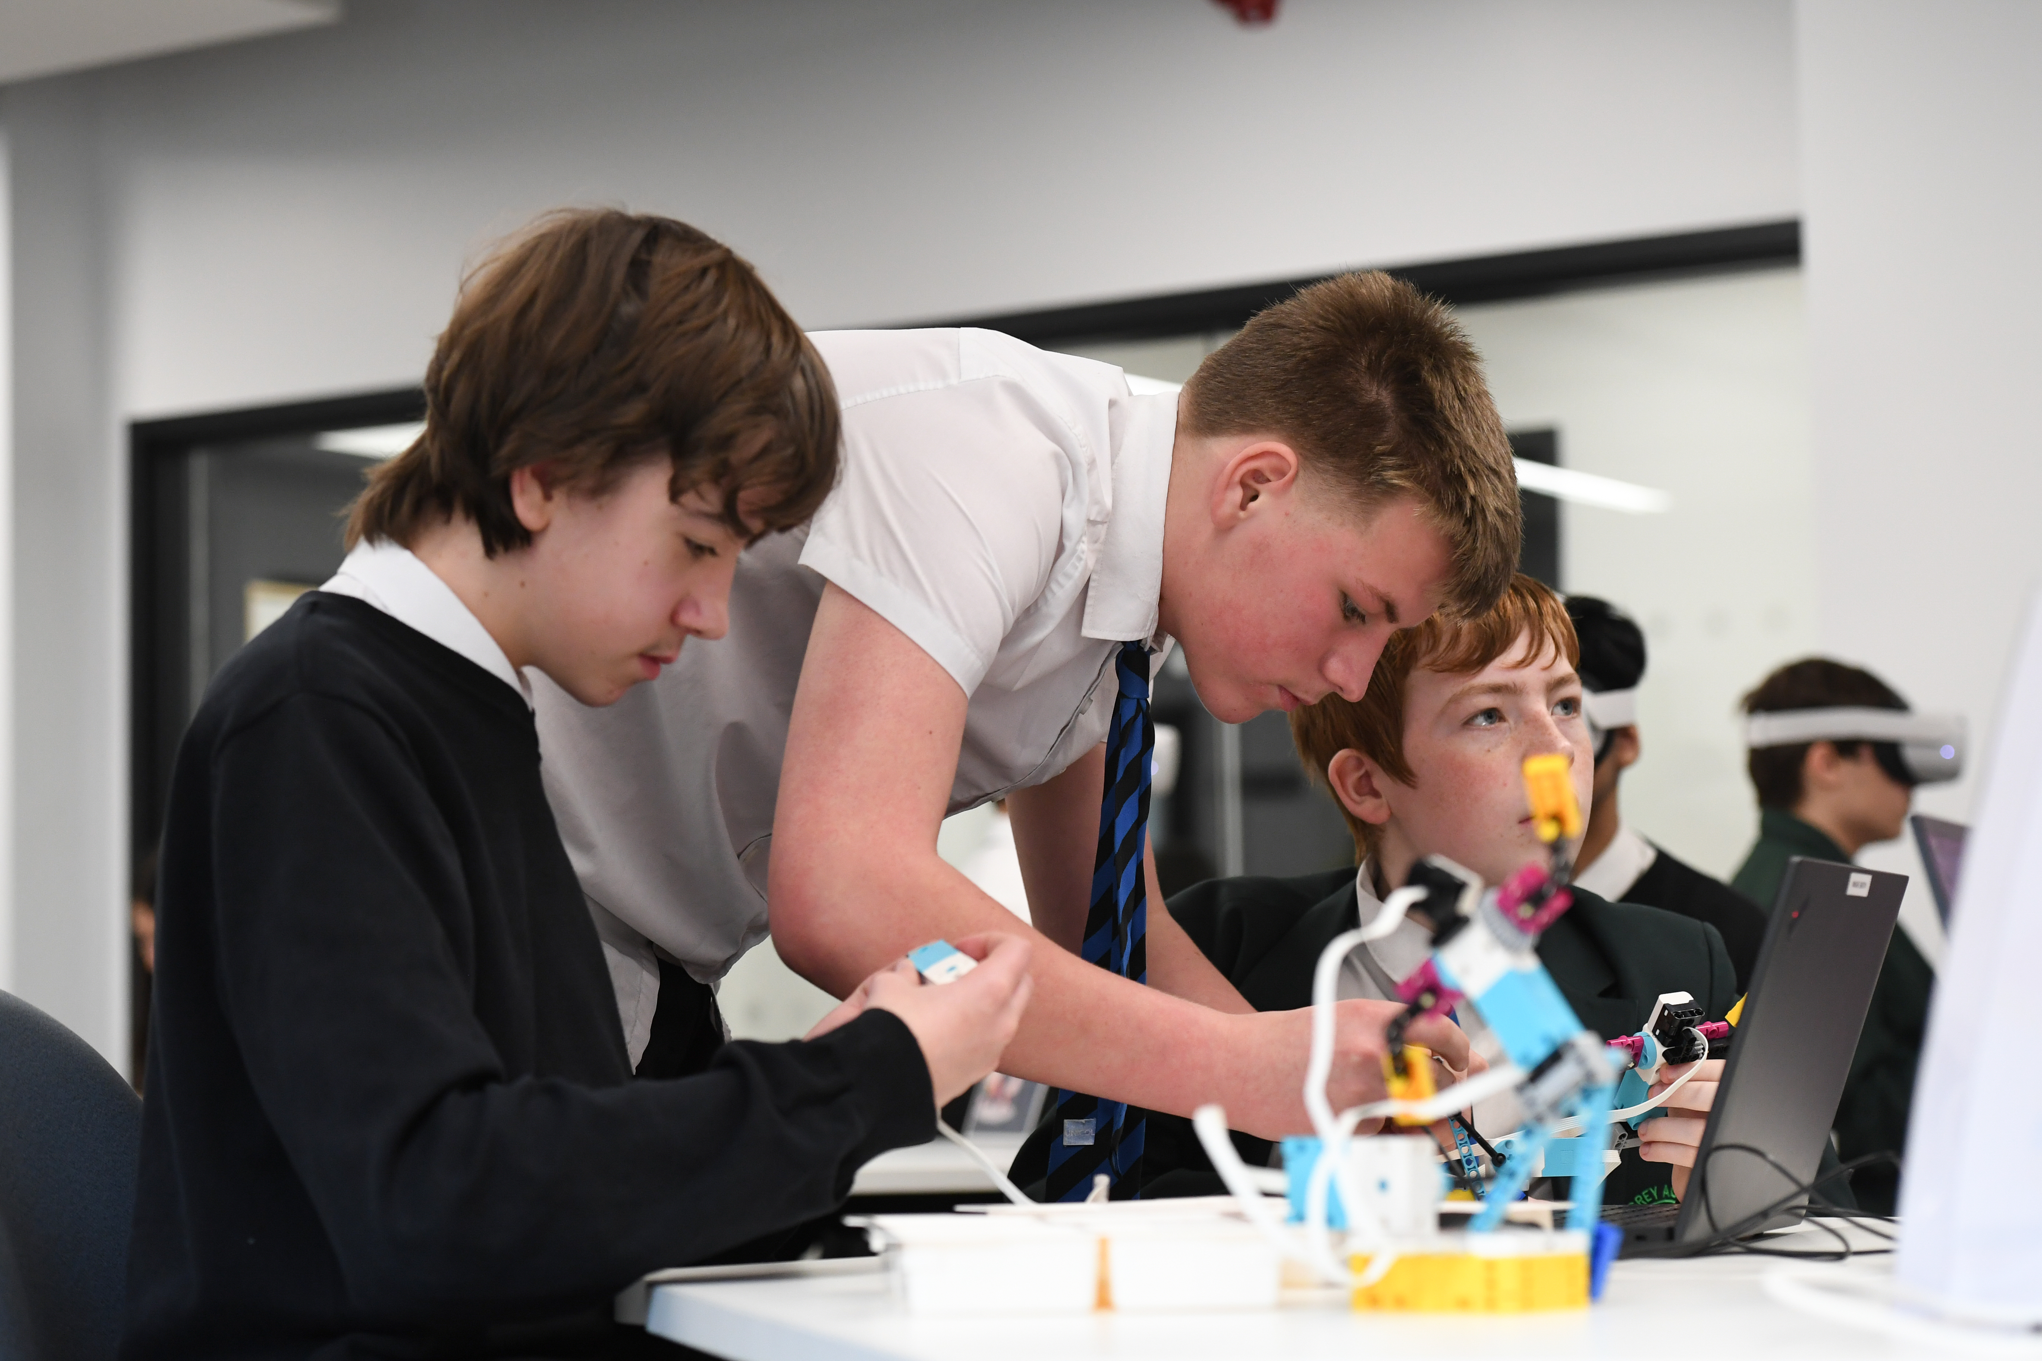
Completed projects
In October 2023, Bletchley Park Trust held an official launch event to open the newly renovated transformation of Block E. This project has positively regenerated this space, providing new educational facilities and an incredible auditorium which will be used to help upskill students. | The Tech Park project, which is jointly funded by MK College, has provided a transformative equipment investment at the South-Central Institute of Technology and will provide higher level technical qualifications, apprenticeships and short courses, helping to bridge the digital skills gap.

Slide 7
Plans for summer engagement
We are currently planning a period of summer engagement on the Town Deal and wider regeneration initiatives happening across Bletchley & Fenny Stratford.
The Town Deal Board will approve the consultation plans and materials in June.
The consultation will then take place across July to September, giving plenty of opportunities to provide feedback both online and in-person.
The Programme team will then respond to feedback (‘you said, we did’) and do the detailed design work, which will take place from September, into Spring 2025.
Construction on Saxon Street and Public Realm Improvements are anticipated Spring 2025.
More information on this consultation will be made available in May 2024

Slide 8
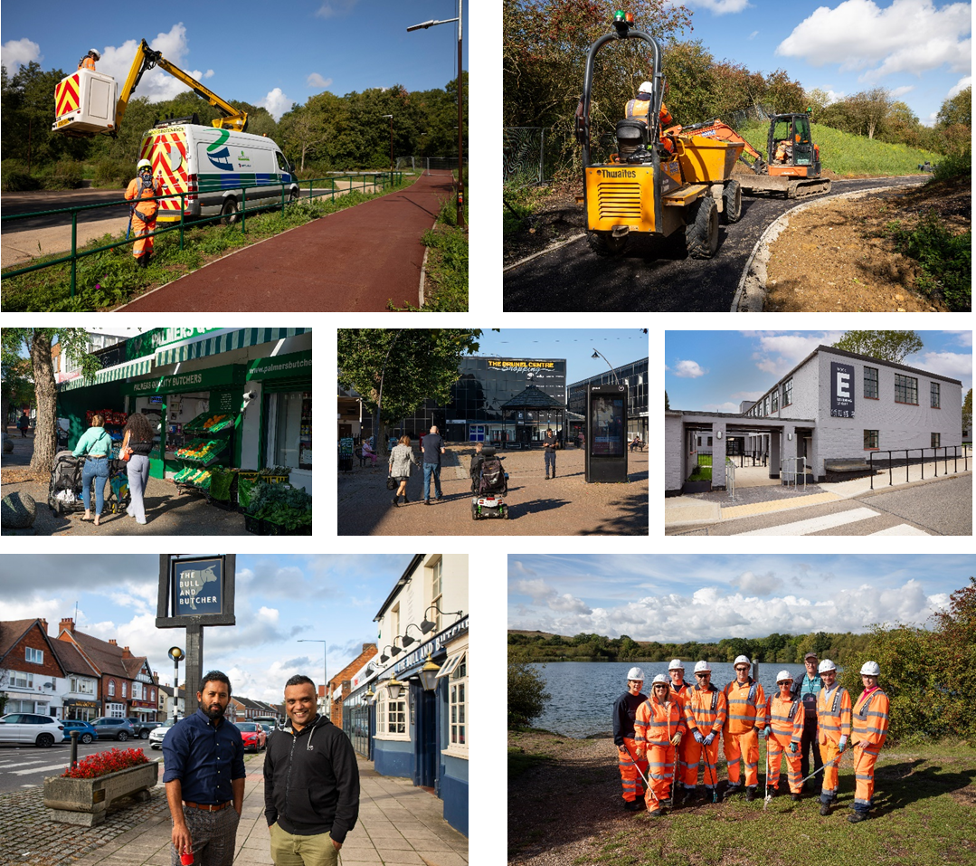

Slide 9

Any Questions

