Slide 1


  Bletchley Park Area Residents Association (BPARA)
  Annual Meeting
  at
  Bletchley Park Auditorium
  on
  Tuesday, 15 April 2025 from 6.30 pm

Slide 2
Agenda
Welcome & apologies for absence
Bletchley & Fenny Stratford Town Deal – Darrel Canvin, MKCC Programme Manager (Town Deal and Infrastructure Projects)
Bletchley Park Update – Iain Standen, CEO
BPARA business:
  Minutes of meeting held on 7 May 2024
  Election of officers
  Accounts – y/e 31 March 2025
  Representatives
Update on other BPARA matters
Neighbourhood Watch – Nick King
Any other business

Slide 3
Speakers
Bletchley & Fenny Stratford Town Deal – Darrel Canvin, Programme Manager (Town Deal and Infrastructure Projects) at MKC
Bletchley Park Update – Iain Standen, CEO
Neighbourhood Watch – Nick King

Slide 4
BPARA Business
Minutes of meeting held on 7 May 2024
Election of officers:
  Chair - Angie Ravn-Aagaard (since 2009)
  Treasurer – Derek Storey (since 2010)
  Secretary – Valda Stuckey (since 2022)
Draft accounts for y/e 31 March 2025
Representatives & Support:
  Leah Attwood, Debbie Castell & Pat Durham
  Shankar Parameswaran, Clive Pepper, Sandra Phillips & Kathy Wilson
  Angela Burnett & Angela Miller – have recently “retired” as representatives
IT Support & Publications – Fiona Storey

Slide 5
Summary of other matters
Activity in year to 31 March 2025 – 108 meetings, of which 18 relate to COBRA only:
Chair represents residents on the Bletchley & Fenny Stratford Town Deal Board, and Valda (Secretary) is a member of its Advisory Group.
Chair of COBRA (Consortium of Bletchley Residents Associations)
Banking Hub
Wilton Hall
G Block, The Wartime Canteen & Cricket Pavilion site
Review of West Bletchley Council Neighbourhood Plan
Parking
Planning matters, including former Santander site
B&FSTC Neighbourhood Plan; Blue Lagoon
Supporter of:
  Friends of Bletchley Station (FOBS) & West Bletchley Shed
  Community Sensory Garden - volunteers and donations welcome via https://www.justgiving.com/crowdfunding/
  Sensory-Garden-West-Bletchley
West Bletchley & Central Bletchley Community Forums & Thames Valley Police
Remembrance Sunday Parade
Pitch at West Bletchley Council’s Carnival in July 2024. For 2025 – theme is Children’s Books (July12)
Speedwatch – volunteers wanted!

Slide 6
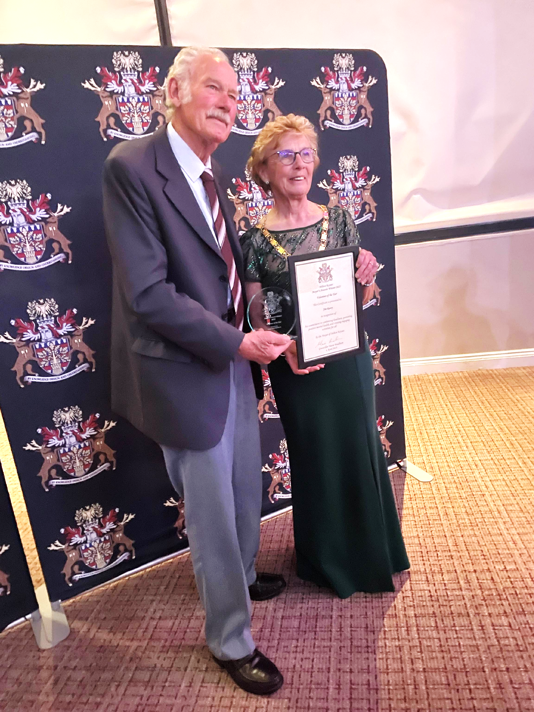
Jim Razey – West Bletchley Shed
Leading member of West Bletchley Shed, based in Rickley Park
Involvement in many community activities including the Community Sensory & the War Memorial Gardens on Church Green.
Ad-hoc jobs for residents such as building raised garden beds and wheelchair ramps
Grateful residents make donations to the Northampton & Warwick Air Ambulance Charity which Jim supports - he has raised £45K.
BPARA nominated Jim for Mayor’s 2025 Volunteer Award – WINNER!

Slide 7
Any other business?

