Slide 1
Bletchley & Fenny Stratford
Town Deal
BPARA Presentation 15/04/25

Slide 2
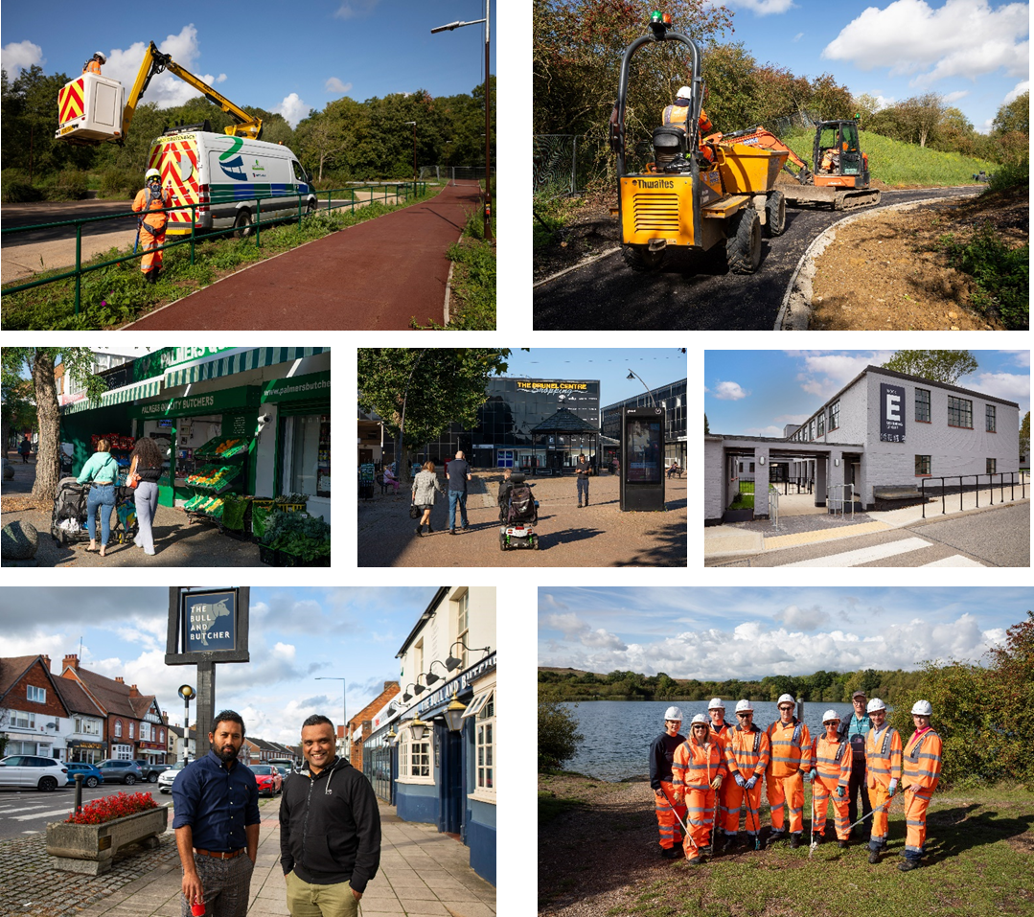

Slide 3
Agenda
Town Deal Overview
Active Projects
  Public Realm Improvements
  Transport Hub / Saxon Street
  Revolving Development Fund
  Redways
  Active Marketing of Vacant Sites
Completed projects
  Tech Park
  Bletchley Park
4) Next Step / Programme of works

Slide 4
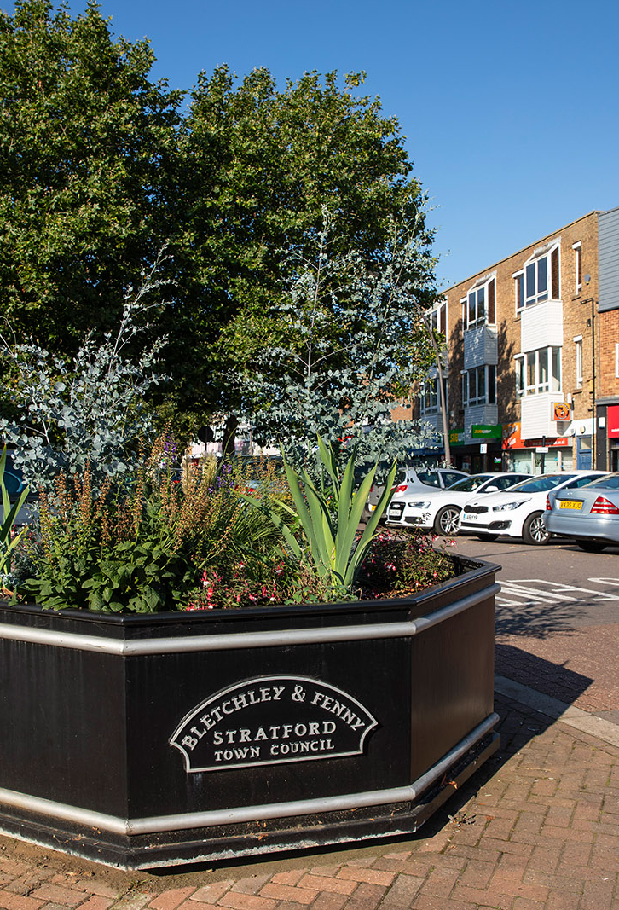
What is the Town Deal?
The Town Deals programme aims to regenerate towns and deliver long-term economic and productivity growth. This is through investments in urban regeneration, digital and physical connectivity, skills, heritage and enterprise infrastructure.
In 2020, Milton Keynes City Council were awarded £22.7 million of Town Deal Funding to deliver several projects in Bletchley and Fenny Stratford that have been selected to drive transformational and sustainable growth in the area.
These projects are designed to capitalise on the emerging opportunities presented by the development of the Oxford to Cambridge East-West rail link, which connects to the Bletchley railway station.

Slide 5
Programme Overview
Project | Description
Revolving Development Fund | This fund is to facilitate the acquisition and re-use of key strategic sites. So far the fund has been used to assemble a number of rundown sites including the Brunel Shopping Centre and the vacant adjacent Sainsbury’s site.
Transport Hub | This will explore opportunities for upgrading Bletchley train station and providing enhanced connectivity to and from the town centre, capitalising on the East-West Rail route. Design being finalised.
Public Realm Improvement (PRI) | This project will provide improved public realm along the main commercial streets, Queensway and Aylesbury Street.
Redway Improvements | This provided new or improved redway links between the Lakes Estate, Newton Leys and Blue Lagoon Nature Reserve to Bletchley Town centre. Project Complete.
Technology Park Bletchley | Tech Park is about providing the delivery of hardware and equipment to support digital skills development for the town, helping to upskill residents and students. Project Complete.
Transformation at Bletchley Park | This project helped renovate facilities at Bletchley Park to provide a new dedicated learning facility, with accessible classrooms and a high specification learning facility. Project Complete.
Active Marketing of Vacant Sites | We are proactively working with local businesses to promote Bletchley and support the development and growth of the local economy.

Slide 6
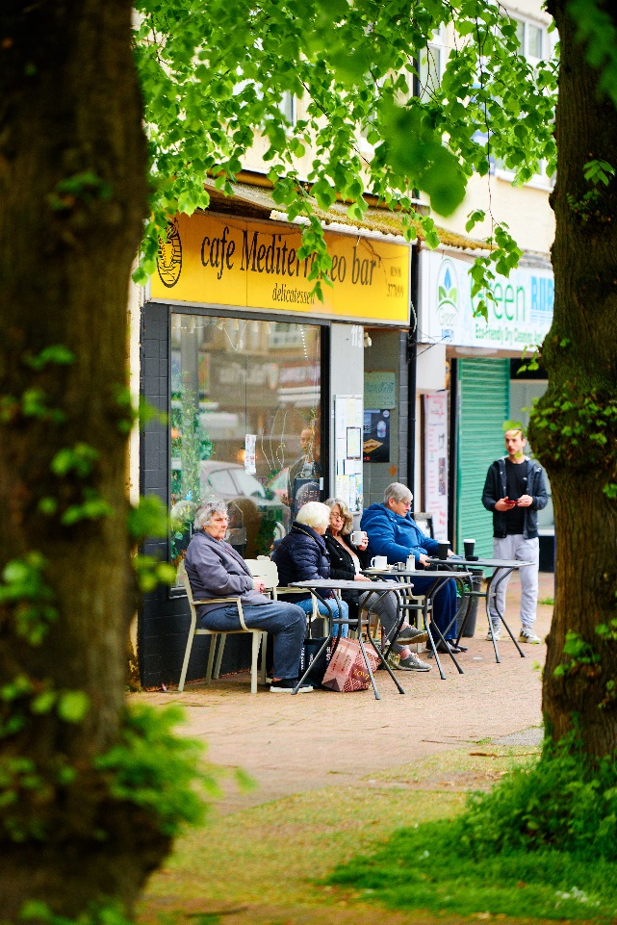
Public Realm Improvements
This project will provide improved public realm along the main commercial streets, Queensway and Aylesbury Street, providing enhanced pedestrianisation and positively improving perceptions of Bletchley for residents, businesses and visitors.
The proposals include new parking spaces, safer pedestrian crossings, street planting & furniture, active travel infrastructure, the narrowing of the carriageway to promote enhanced pedestrianisations and the implementation a one-way traffic flow.
Detailed design work is now underway, with construction expected to start in Summer 2025. A smaller project on Aylesbury Street is due to start in June 2025.

Slide 7
Objectives
The public realm improvements project will create a more thriving and vibrant town centre. The proposals for this project were developed to achieve the following business case objectives:
To improve the attractiveness of the town centre
To increase footfall and time spent in Bletchley and Fenny Stratford.
To improve the safety of public space and reduce the reported incidents of anti-social behaviour and crime.
To improve the link between Bletchley Railway Station and Bletchley Town Centre.
To improve the health and wellbeing of Queensway and Aylesbury Street.

Slide 8
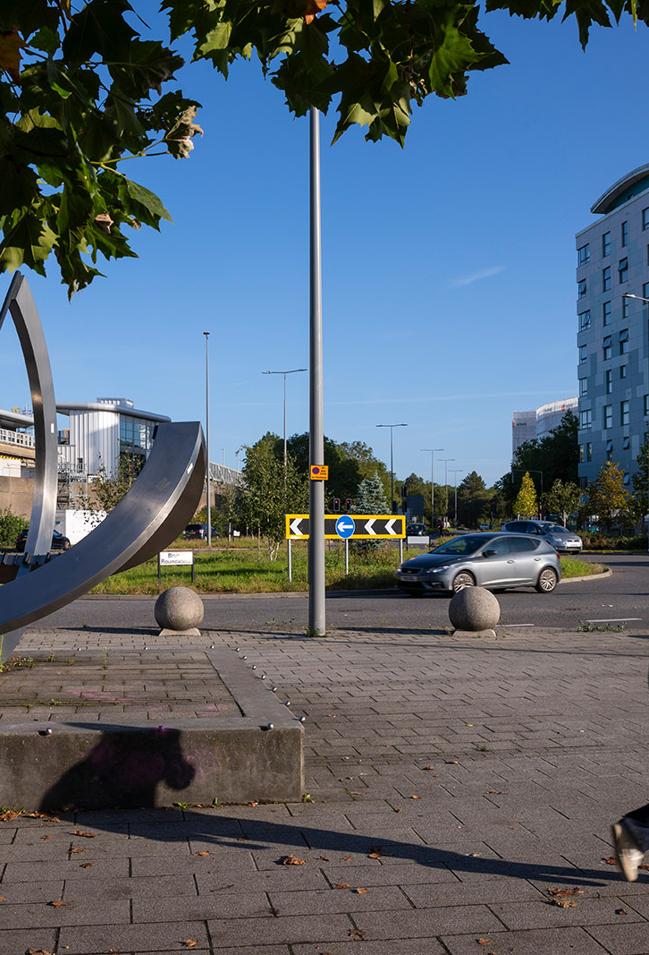
Transport Hub
This project will explore opportunities for upgrading Bletchley Train Station, which will provide enhanced connectivity to and from the town centre and help capitalise on the emerging opportunities presented by Bletchley’s central position in the East-West rail network.
The designs will see the reduction of the existing carriageway, which dominates and obscures the landscape and help upgrade existing bus facilities, provide new redway links, upgraded public realm, pedestrian crossing points and associated public realm.
It will also provide sufficient land to help enable and protect the future aspiration of creating an eastern entrance from the train station, connecting into Saxon Street and Queensway.

Slide 9
Objectives
Our proposals will help improve connectivity between the Town Centre, railway station, Bus Station, creating an multi-modal transport interchange where people can more easily travel. The proposals for this project were developed to achieve the following business case objectives:
To provide a transport system that makes it easier to get around and supports sustainable travel choices.
To ensure a safer, healthier and more accessible transport network.
To narrow the road carriages in certain areas to safely accommodate vehicular movements and pedestrian flows.
To help the businesses located in Central Bletchley, particularly in Queensway, by providing better connections to new customers.

Slide 10
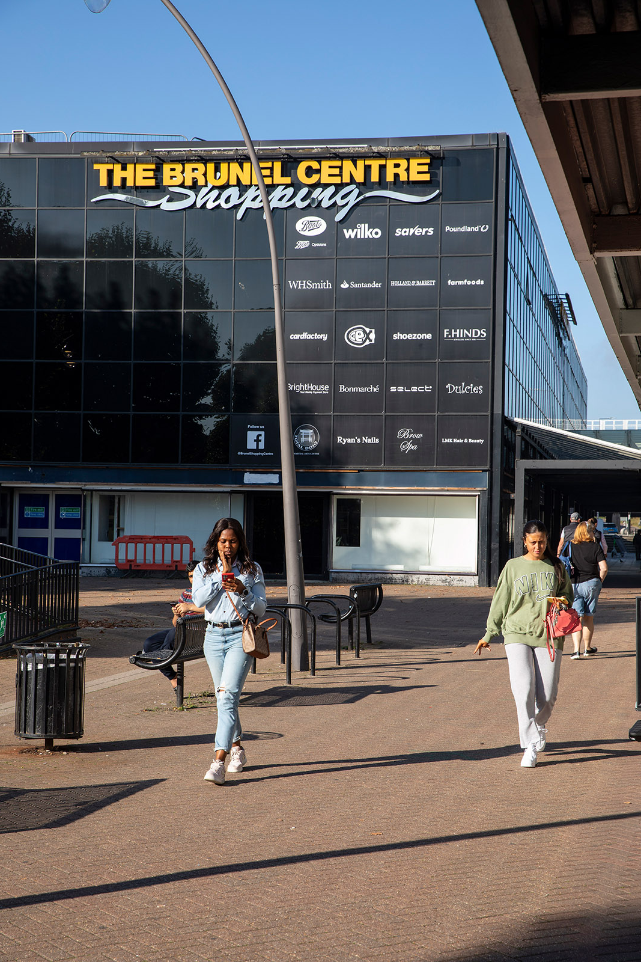
Revolving Development Fund
This fund will help facilitate the acquisition and re-use of key strategic sites around the area. The funding is anticipated to be utilised in tranches over a 10-year operation period and the fund has already enabled the acquisition of the vacant Sainsbury’s site adjacent to the Brunel Centre.
A redevelopment brief was approved for the Brunel Centre in 2024 and sets out guidance and parameters for any future development. This advocates a mixed-use development, including housing, leisure & retail.
The Council are currently working on procuring an ambitious development partner to positively transform this site and will be marketing this in Spring 2025. Demolition of the Brunel is anticipated in 2026.

Slide 11
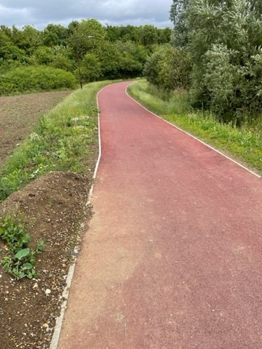
Redways
The Redways scheme is nearing completion (minor landscaping works ongoing) which has provided enhanced connectivity from the Lakes Estate, Newton Leys and Blue Lagoon Nature Reserve.
The Council are also looking at future Redway connections and aspire to connect this route all the way to the Town Centre. Design work is ongoing but this addition is not yet funded.
The Council are also working with local stakeholders to arrange a blue lagoon parkrun. Work for this is still ongoing and the team are hoping this will be operational is Spring/Summer 2025.

Slide 12
Active Marketing of Vacant Sites
The AMoVS project aims to market Bletchley as a great place to invest and do business, by engaging with businesses across the area.
The project has delivered several successful initiatives to support businesses including a business grant scheme (which has supported 25 businesses), creation of a new business narrative and regular networking events.
Future initiatives include enhanced promotion of Bletchley as a business location across the Oxford-to-Cambridge arc and promotional campaigns, ensuring that the Highstreet remains open and visited during the construction programme.

Slide 13
Bletchley Park
Tech Park (MK College)

Slide 14
Next Steps / Programme of works
The programme team have arranged an extraordinary Town Deal Board meeting (April 22) to review the final plans for Saxon Street.
In May 2025, the programme team will launch a comprehensive communication campaign which will show artist impressions of approved schemes and consist of a leaflet drop and pop-workshops to inform the public and give the community the opportunity to ask questions.
Construction on Aylesbury Street is anticipated for June 2025 and will likely last 6-8 weeks.
Construction on Queensway is anticipated to commence in the summer, post the Bletchley Big Eat event.
Construction on Saxon Street is anticipated to commence in early 2026.

Slide 15
Groundbreakingbletchleyandfenny.co.uk

