Slide 1
Reinvigorating Neighbourhood Watch
Milton Keynes & District Neighbourhood Watch Association
Nick King
Bletchley Park Area Residents Association
15th April 2025

Slide 2
Background
Launched in England in 1982
Four tier structure:
i. The national charity: Neighbourhood Watch Network
ii Force Area Associations based on Police Force areas
iii. District & Regional associations and groups
iv. Grassroots groups or schemes: neighbourhood and community level
The largest crime prevention voluntary movement in England and Wales and has upwards of 2.3 million members.

Slide 3

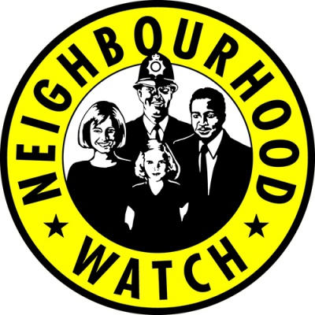

We are well known…!

Slide 4
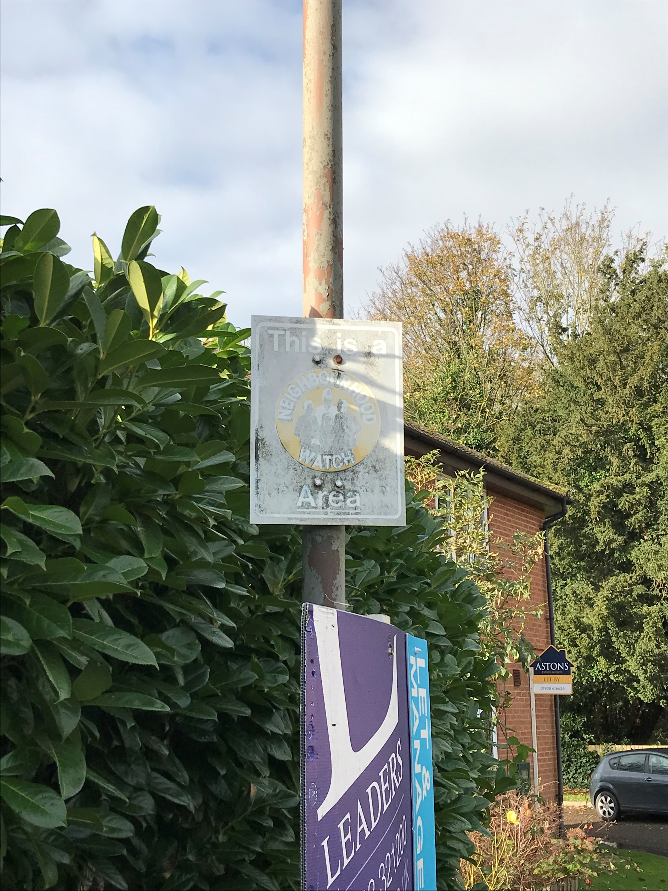
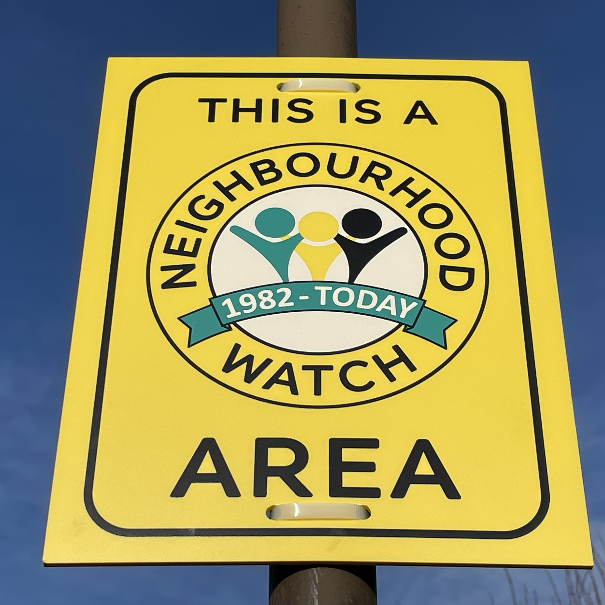
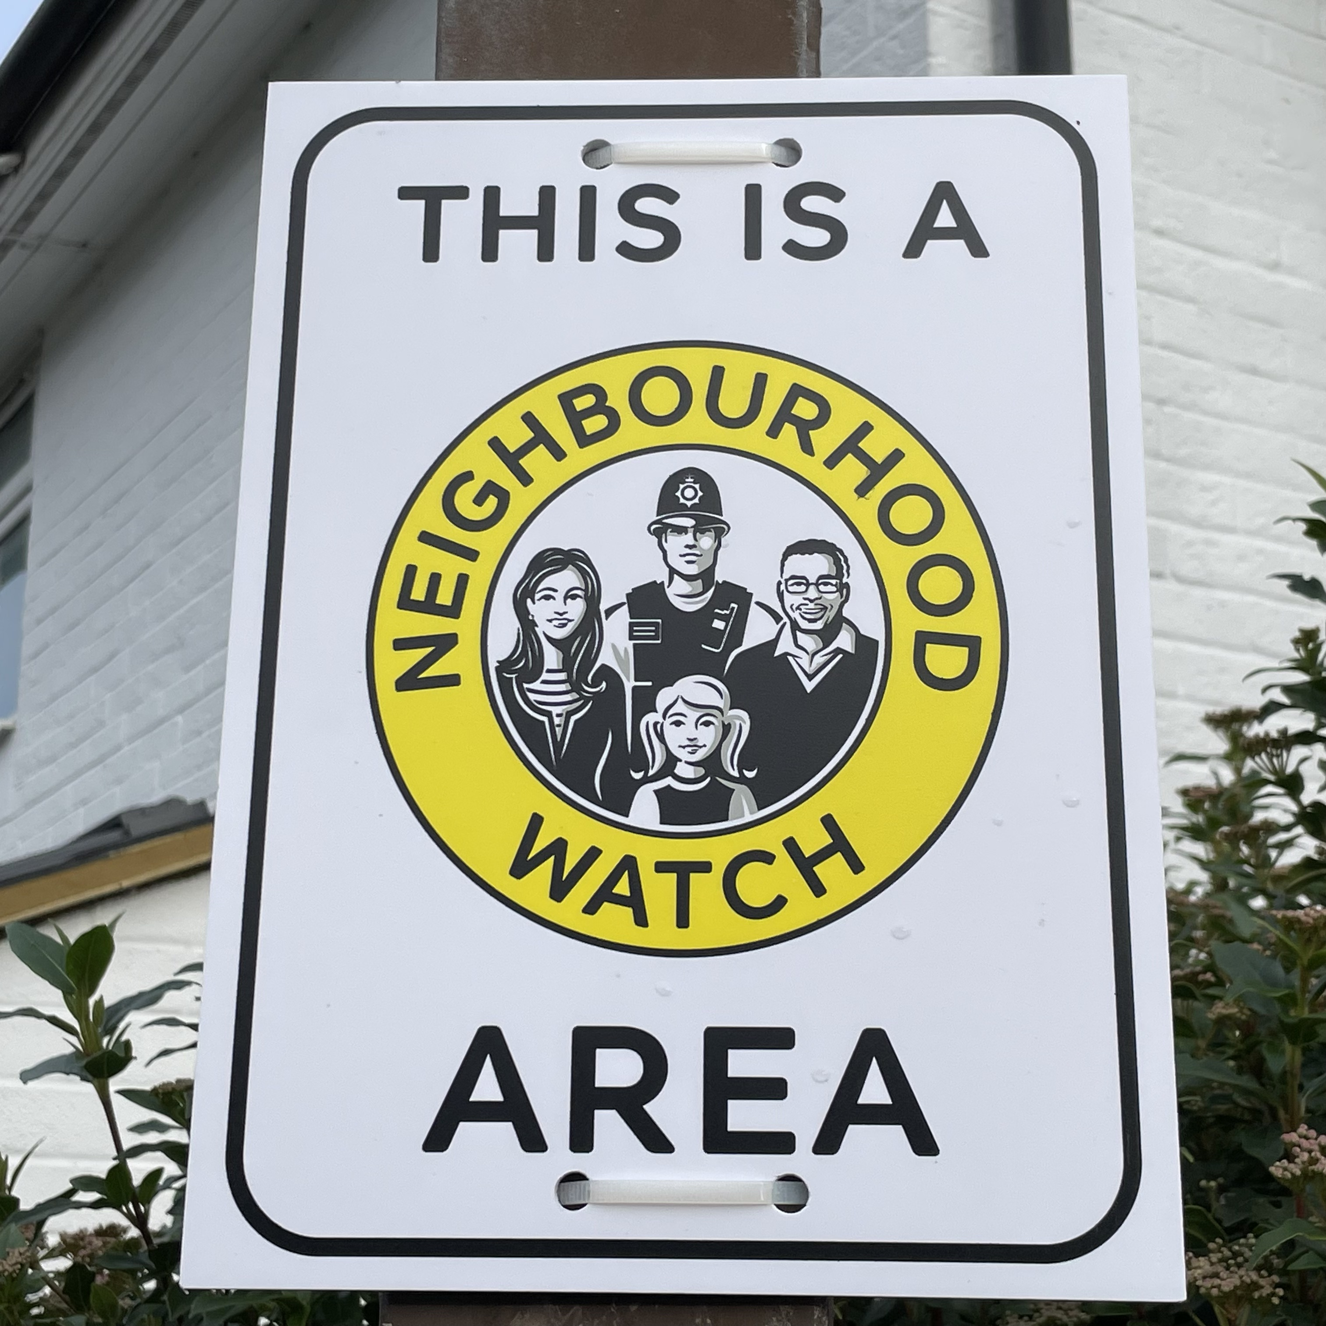
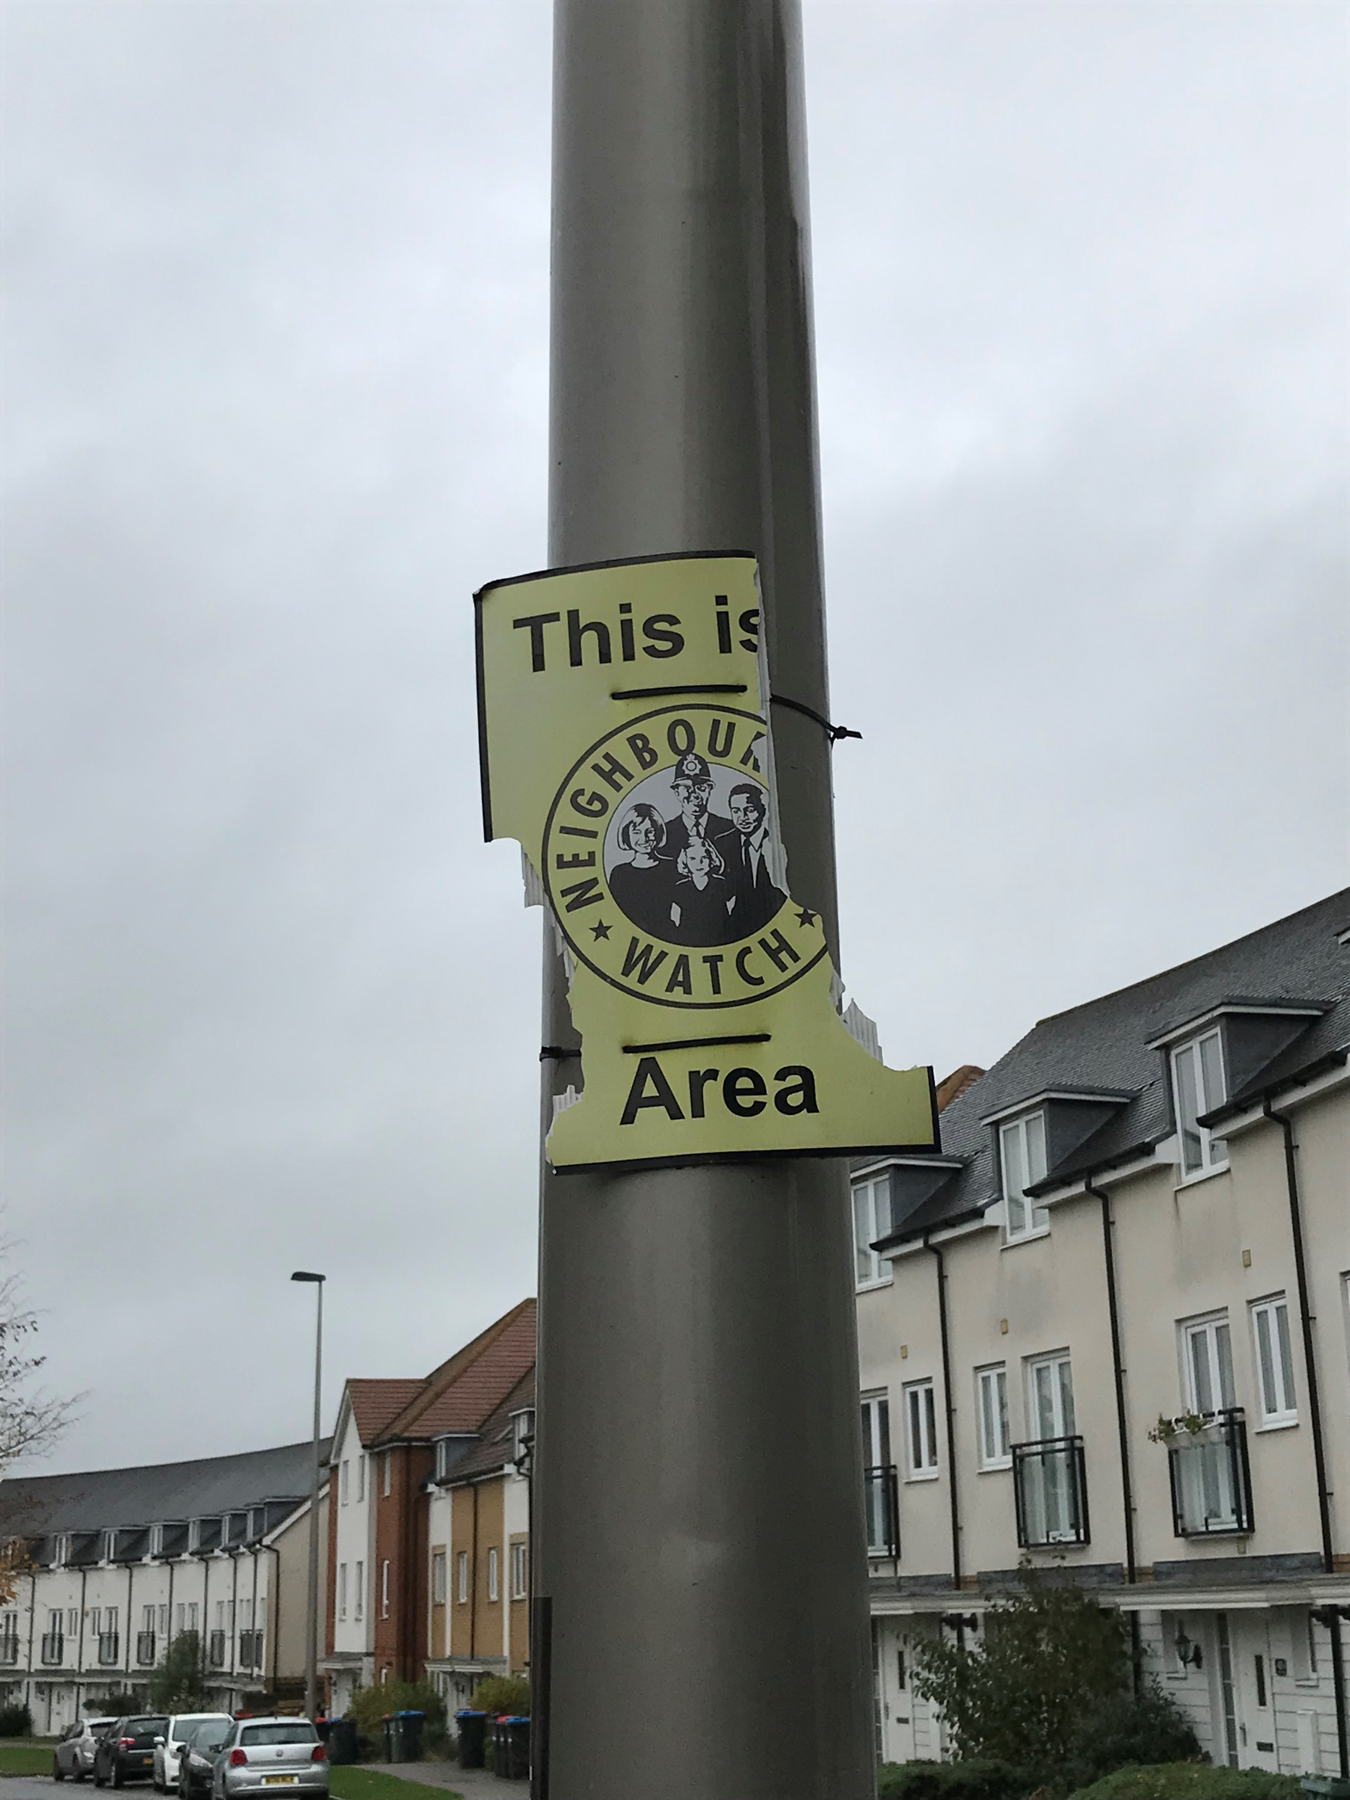
However, we’ve work to do…

Slide 5
Our 3 steps to Neighbourhood Watch
We want neighbours to come together to create safer, stronger and active communities.
Sign-up to Thames Valley Police Alerts via ourwatch.org.uk
Do the postcode search and join a group if there’s one where you
live.
If no local group, you can apply to start your own…..
We have over 210 volunteer Watch schemes across Milton Keynes
so you are in good company!

Slide 6
What’s involved with running a scheme?
(i) On ourwatch.org.uk name and map your scheme and submit.
(ii) This messages the Association: a team member visits you to talk it
through.
(iii) Once you and your scheme are approved, it becomes visible on the website.
[Note: your contact details are not shown. Nor can members see you or
other members, only you as the coordinator can see data.]
(iv) As coordinator you receive for your community/households free
membership leaflets, hi-viz street-signs, stickers, crime prevention
literature, etc.
(v) Your local Police will email you a welcome and their contact information.
(vi) Encourage to link with your Town/Parish Council and social media channels.

Slide 7
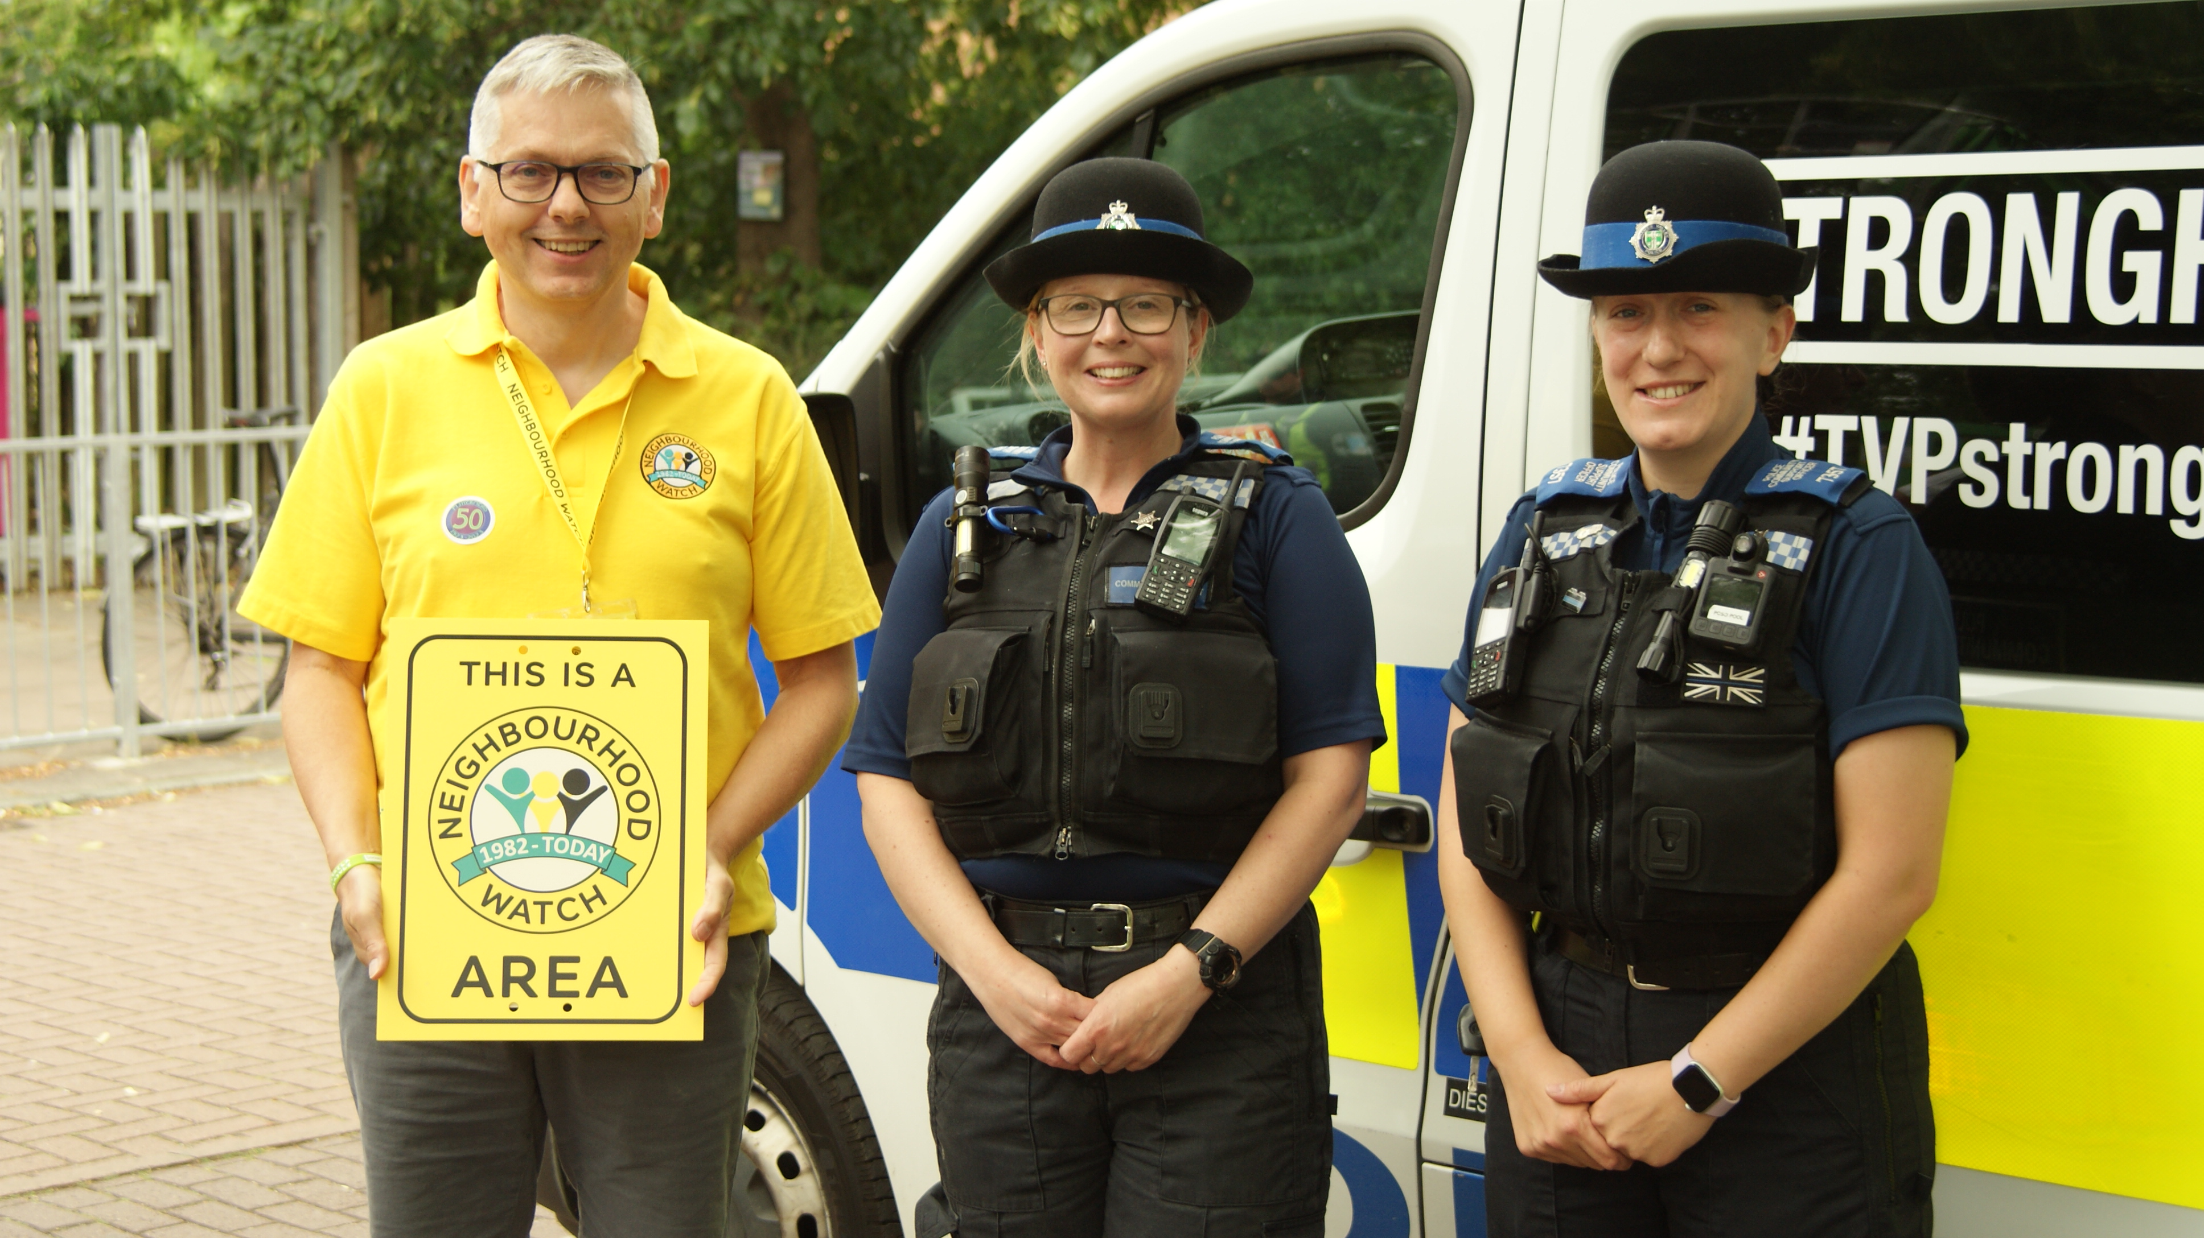

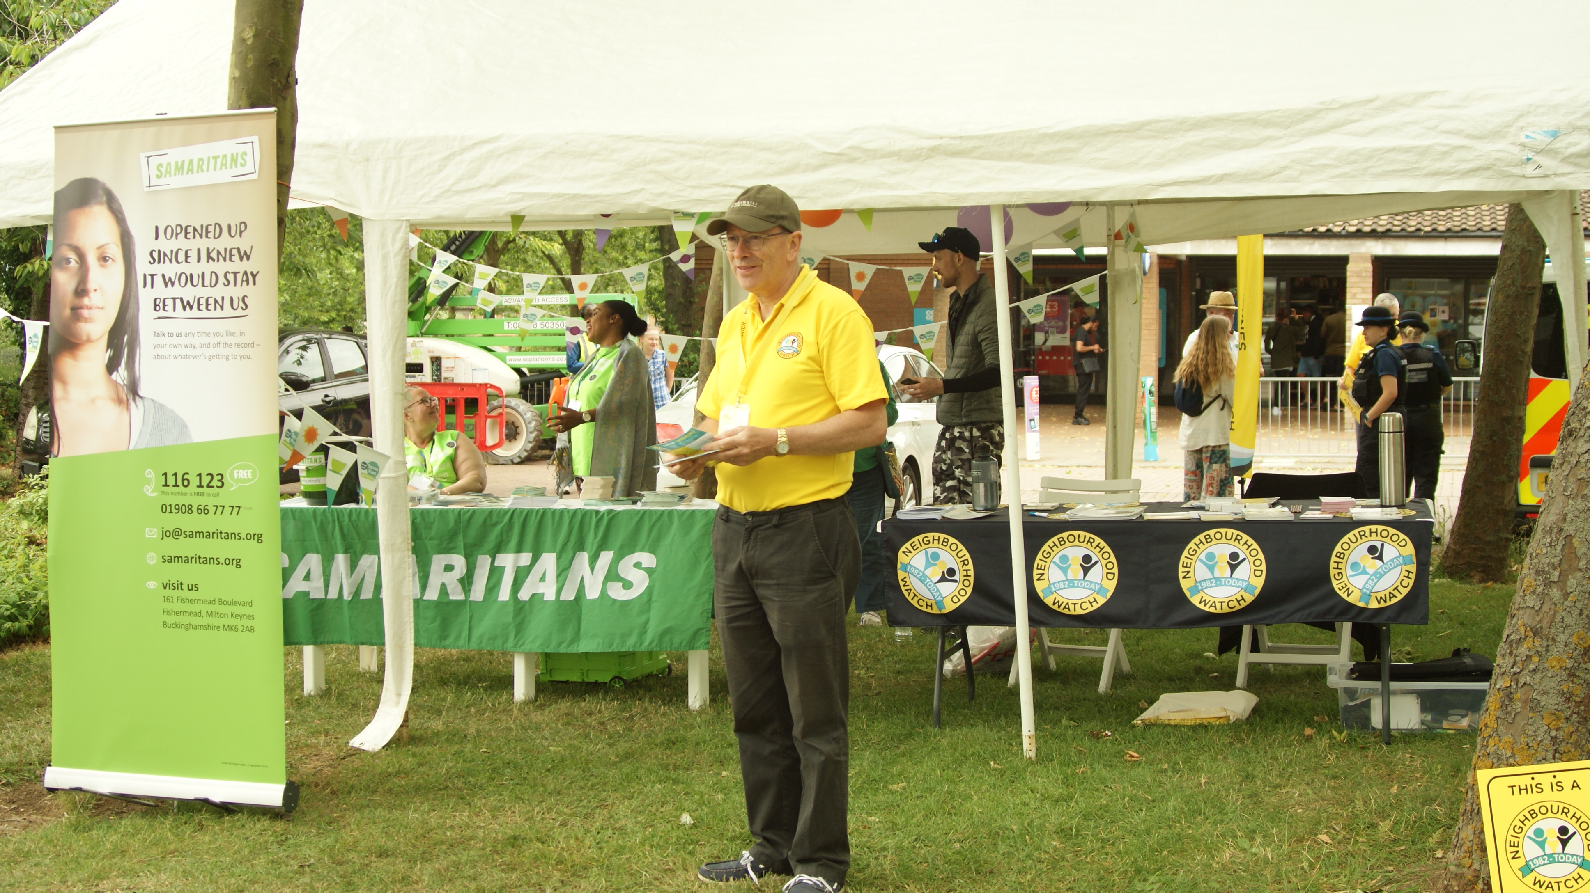
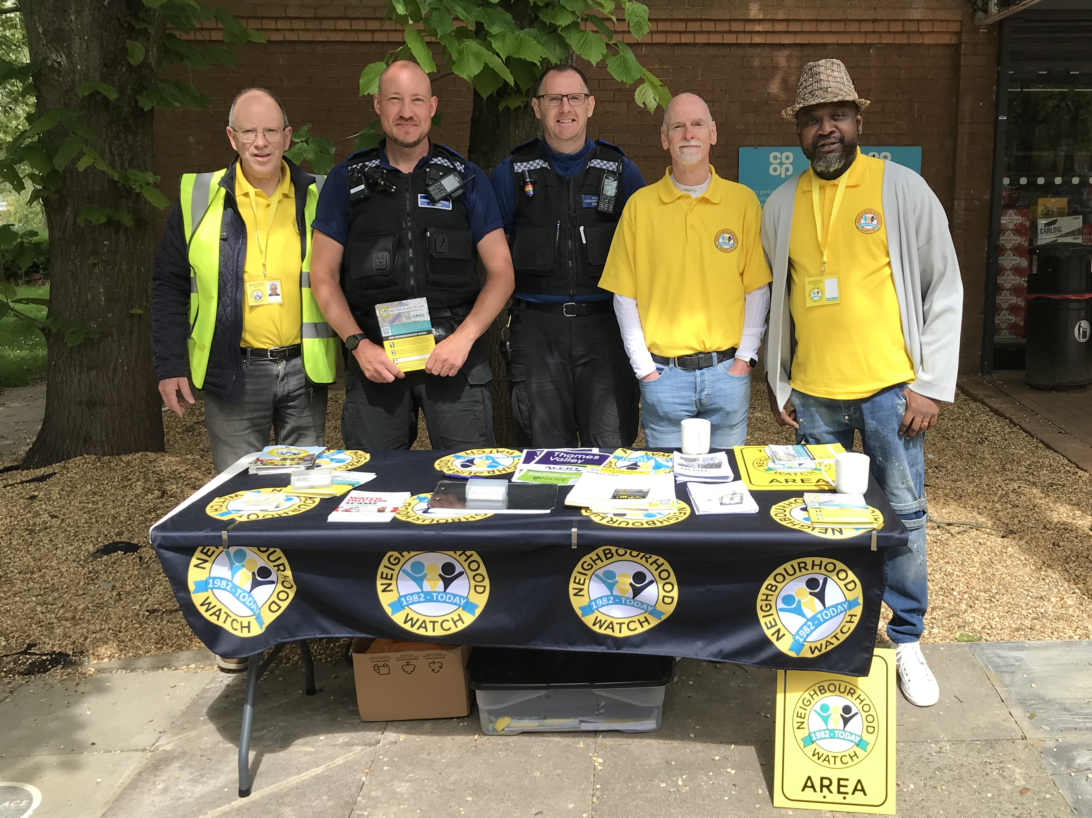
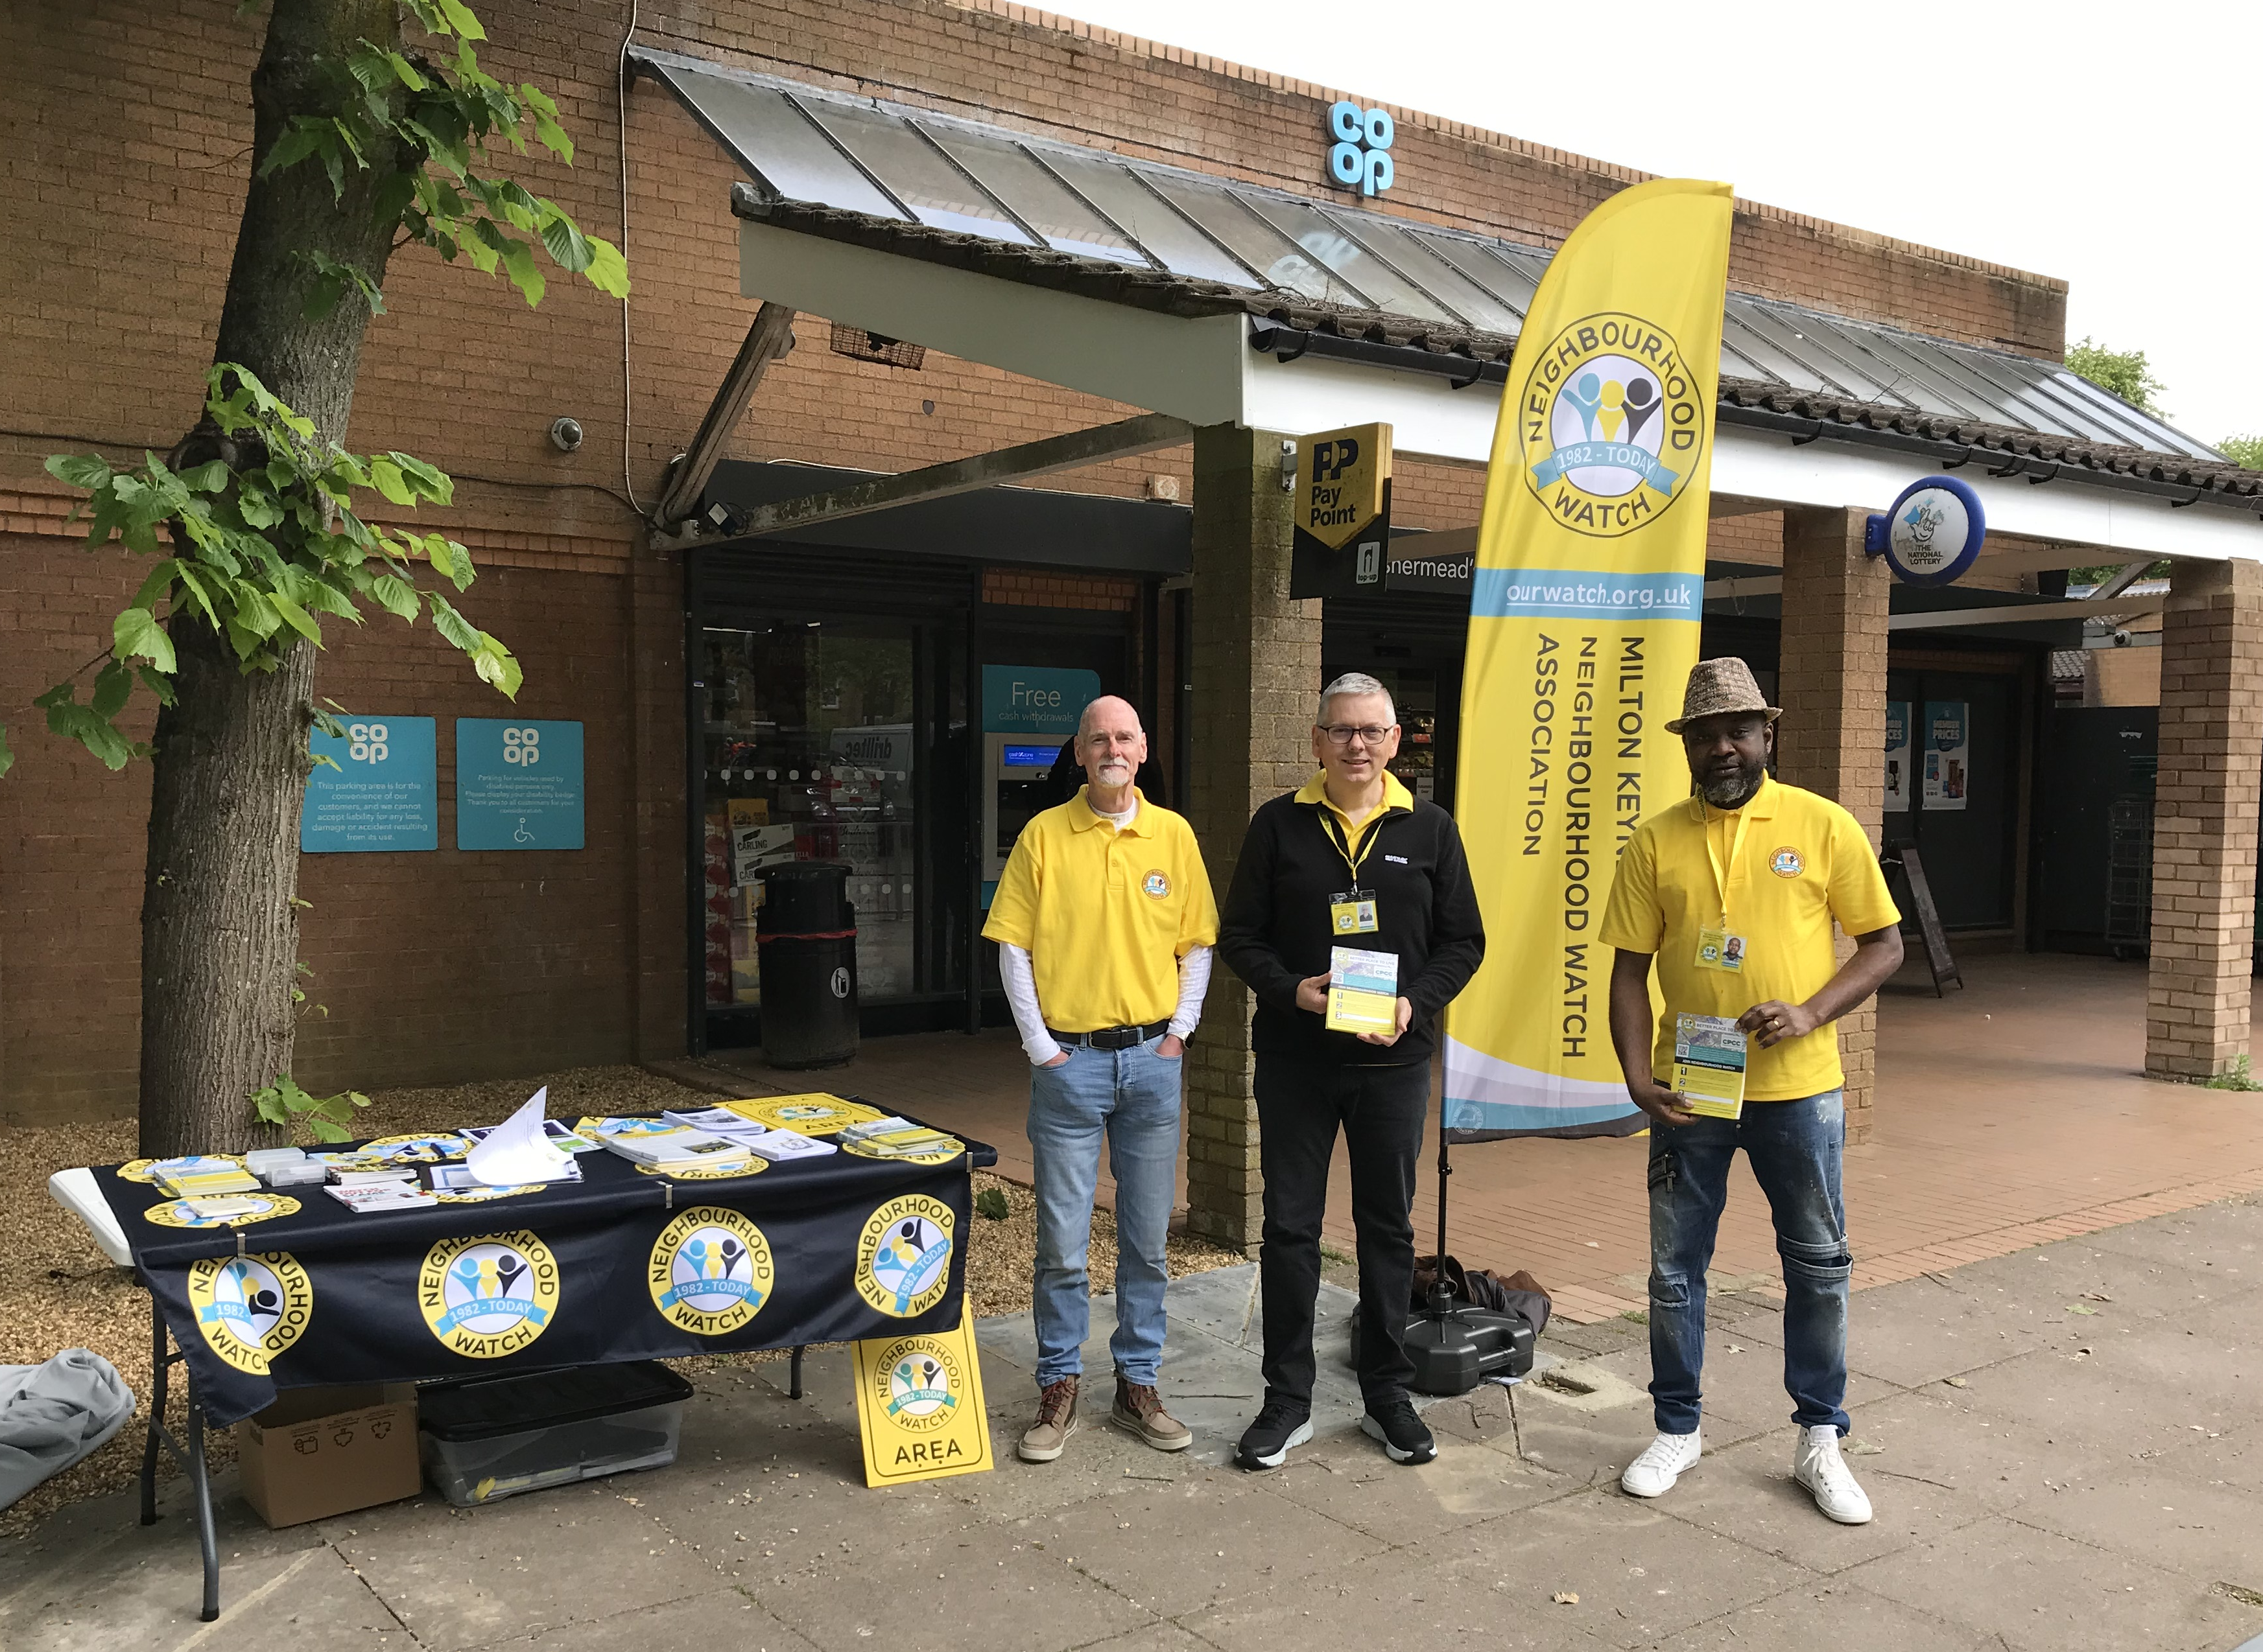
Fishermead

Slide 8
Contact:
Nick King
Chair, Milton Keynes Neighbourhood Watch Association
chair@mknhwa.org.uk

